Slide 1



POSCO International CRM Innovation TF
User Manual_Meeting Memo
2025. 10

Slide 2
Contents_PC
Step 1
Meeting Memo Creation
Register New Meeting Memo 1.1 Select Record Type 1.1.1 Use CLOVA Note 1.1.2 Use Teams 1.1.3 NDA Account 1.2 Enter Basic Information 1.3 Enter Meeting Details 1.4 Enter Attendance Information 1.5 Save and Submit 1.6 Add Additional Information and Utilize Features
Meeting Memo Editing 2.1 Editing from the Meeting Memo List View 2.2 Editing from the Meeting Memo Detail Page

Slide 3
Contents_PC
Step 2
Meeting Memo Saving / Submission
Temporary Save and Submit 1.1 Edit Draft Information and Submit
Email and Notification Delivery 2.1 Set Recipients / CC 2.2 Review Sending Template and History
Step 3
Meeting Memo View
View Meeting Memo List 1.1 View from Home Screen 1.2 Use Filters in List View to Search Meeting Memos
View Detailed Meeting Memo 2.1 View Related Information 2.2 View Sensitive Information and Sharing Targets 2.3 View To-Do List

Slide 4
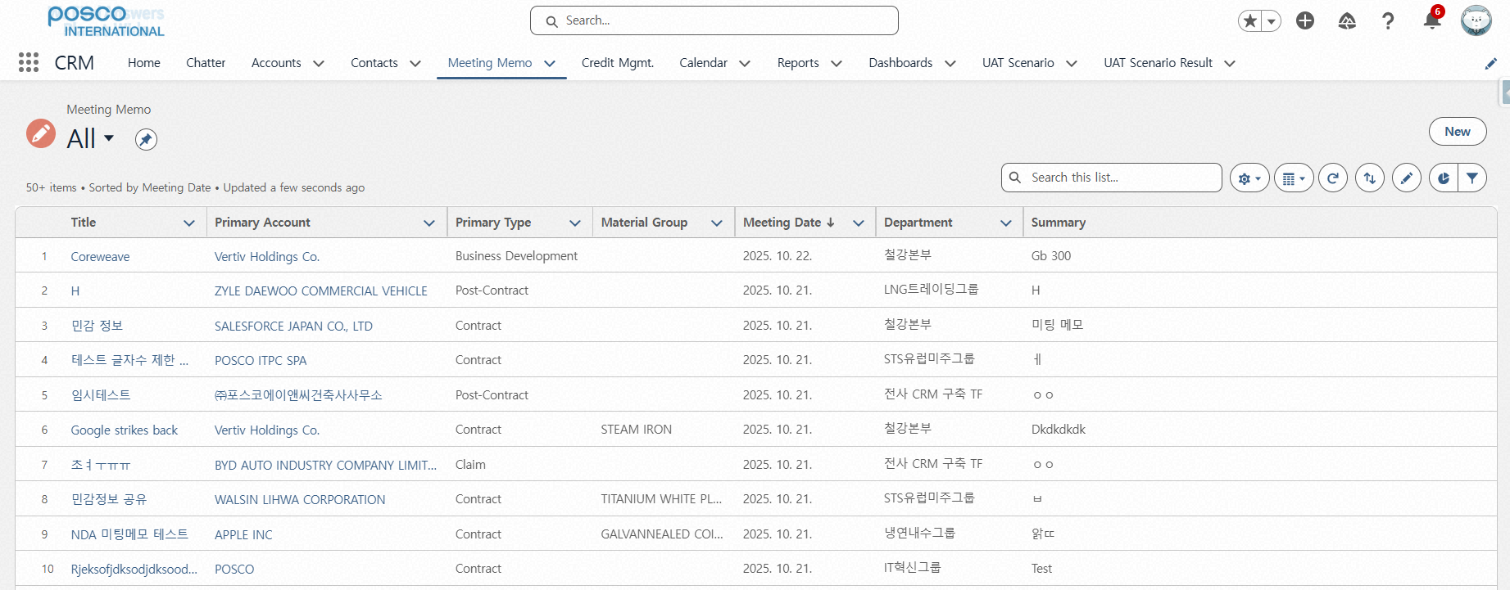
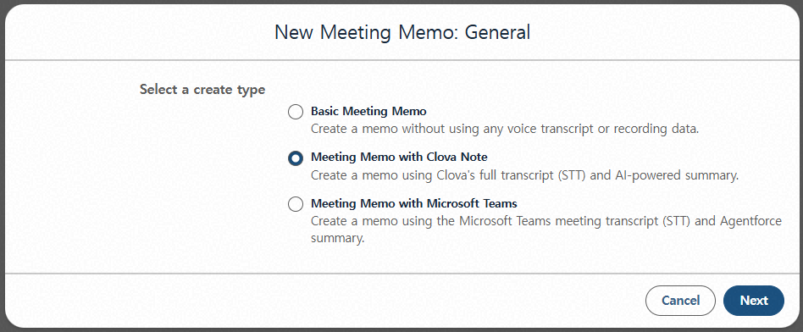
Step 1. Meeting Memo Creation
Step (Lv.2) | 1. Register New Meeting Memo | Step (Lv.3) | 1.1 Select Record Type_1.1.1 Use CLOVA Note
Menu | Meeting Memo | User | All Employees
Navigation | Home > Meeting Memo Menu > New Meeting Memo Popup
Click Create New
Select Create Meeting Memo Using CLOVA Note
Click Next
1
2
3
FAQ
Q. Can I create a Meeting Memo without using the AI solution, as before? A. Yes. By selecting Basic Meeting Memo, you can create a Meeting Memo using the previous method.

Slide 5
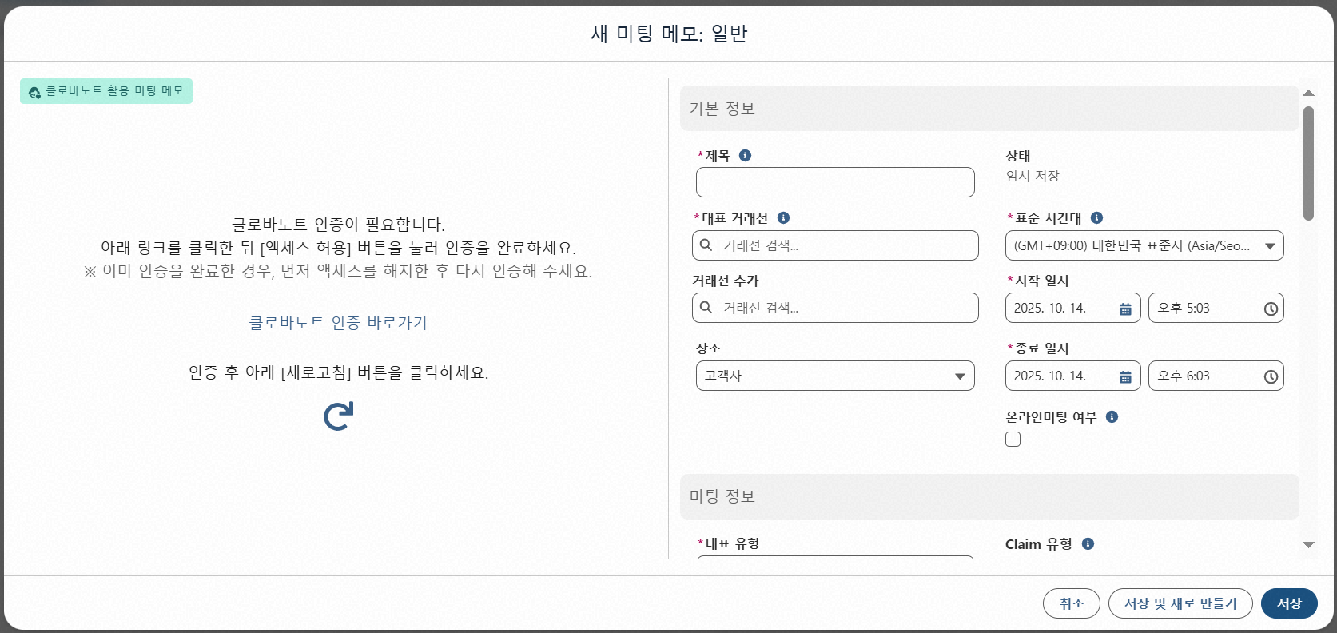
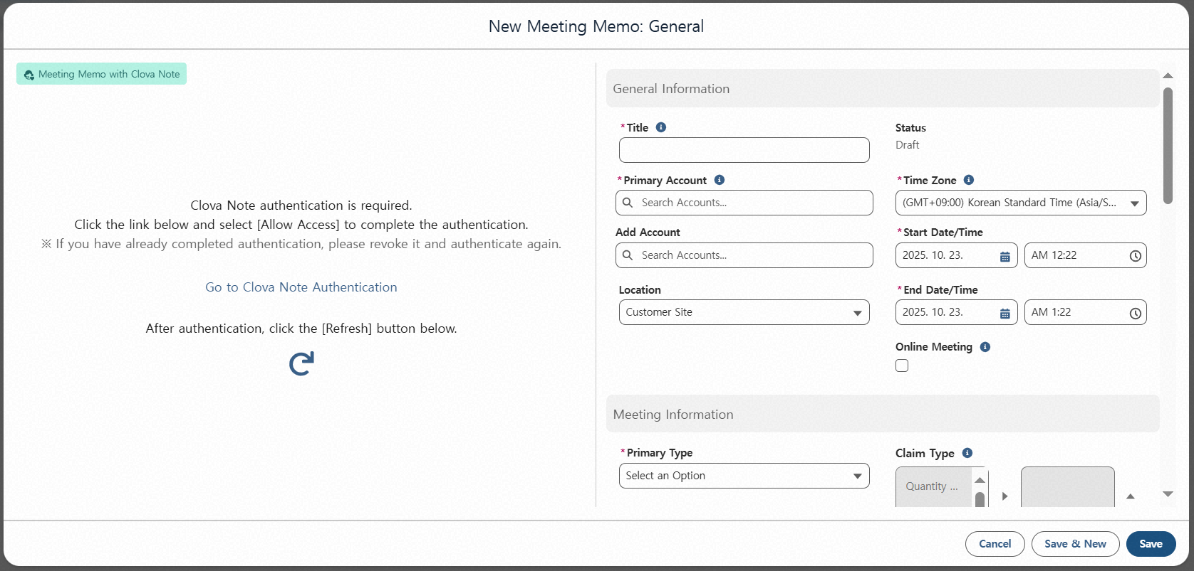
Step 1. Meeting Memo Creation
Step (Lv.2) | 1. Register New Meeting Memo | Step (Lv.3) | 1.1 Select Record Type_1.1.1 Use CLOVA Note
Menu | Meeting Memo | User | All Employees
Navigation | Home > Meeting Memo Menu > New Meeting Memo Popup
Click Go to CLOVA Note Authentication - Authentication is required when creating a Meeting Memo using CLOVA Note for the first time. - Re-authentication is required every 90 days (the same authentication request screen will appear).
1

Slide 6
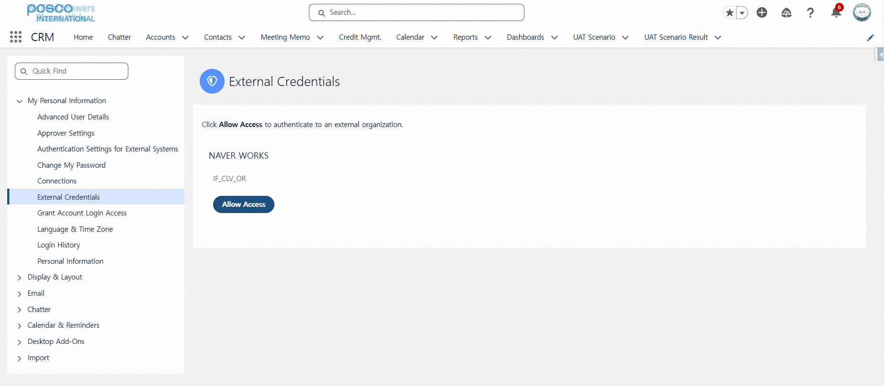
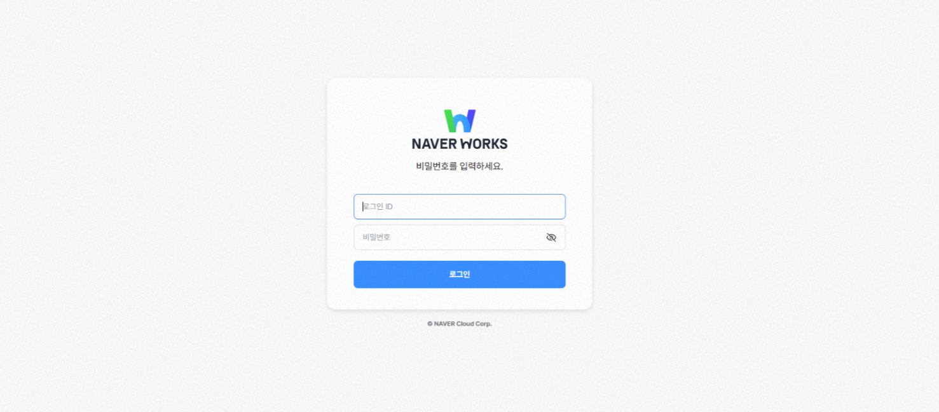
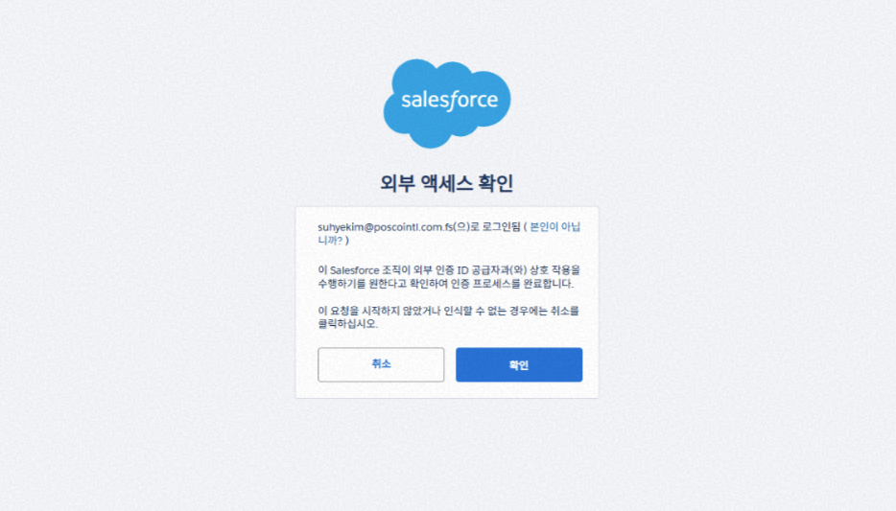
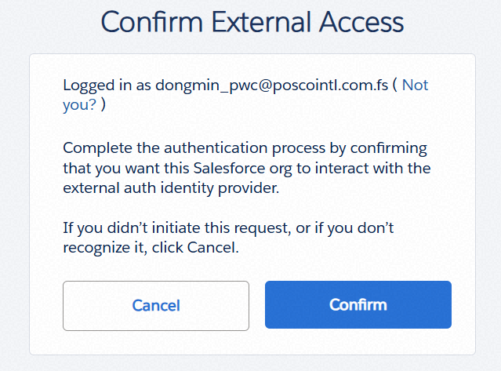
Step 1. Meeting Memo Creation
Step (Lv.2) | 1. Register New Meeting Memo | Step (Lv.3) | 1.1 Select Record Type_1.1.1 Use CLOVA Note
Menu | Meeting Memo | User | All Employees
Navigation | Home > Meeting Memo Menu > New Meeting Memo Popup
Click Allow Access - Authentication is required when creating a Meeting Memo using CLOVA Note for the first time. - Re-authentication is required every 90 days (the same authentication request screen will appear)
CLOVA Note Account Login - A separate request and issuance are required to obtain a CLOVA Note account. (Responsible Department: IT Planning Group).
Click Confirm
1
2
FAQ
Q. I can’t log in with my usual intranet (EP, etc.) account. How can I log in? A. You can request and receive a CLOVA Note account from the IT Planning Group.
Login
3

Slide 7
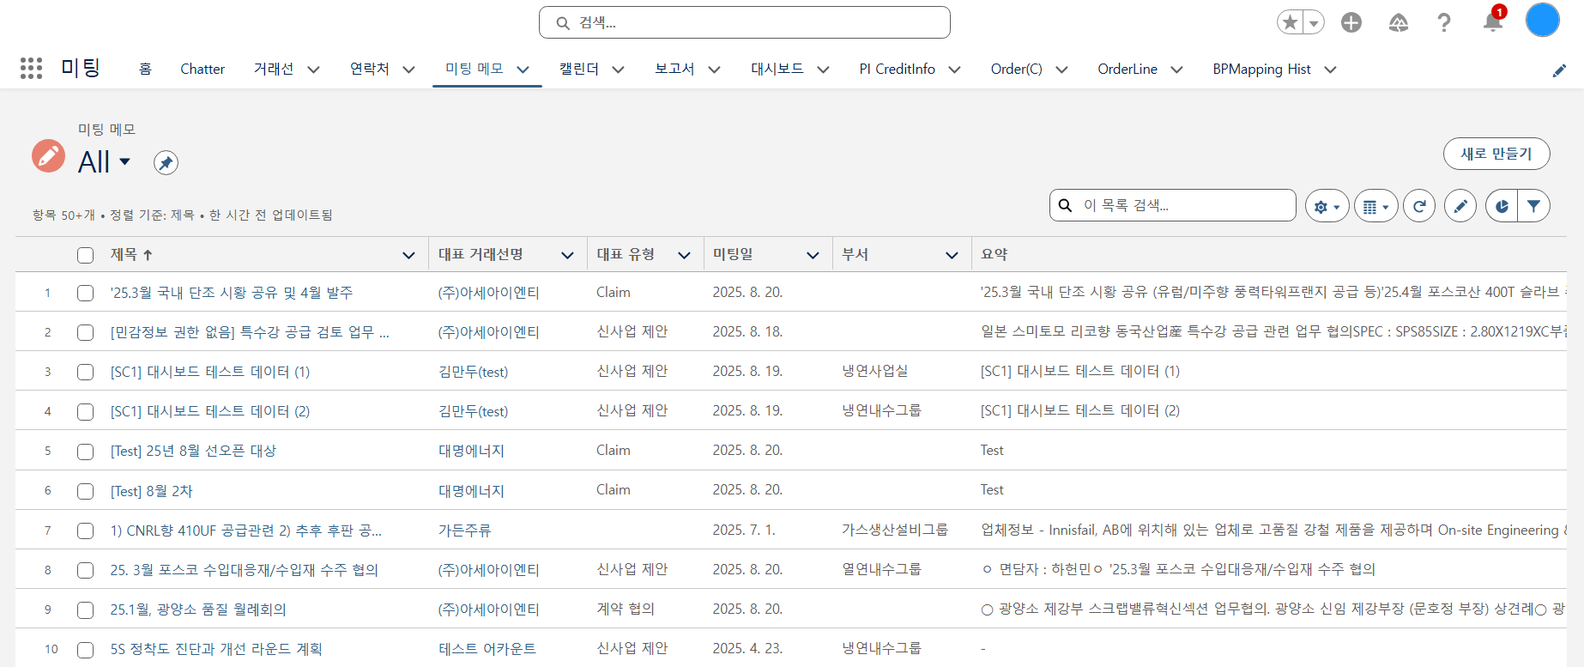
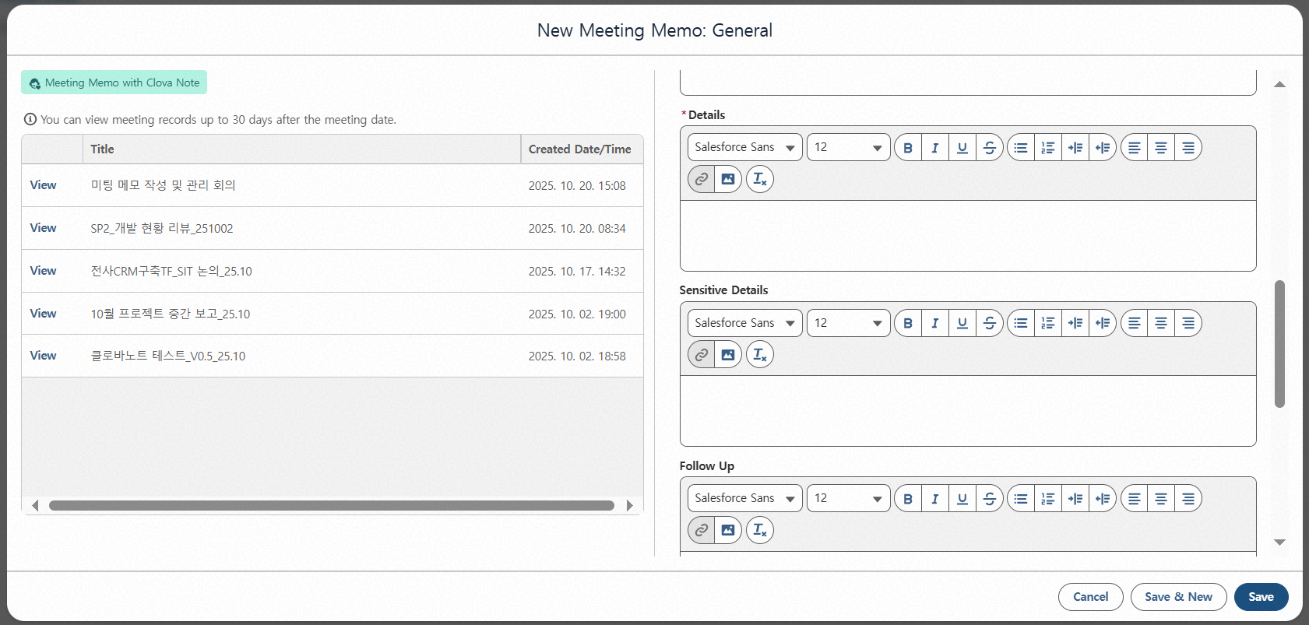
Step 1. Meeting Memo Creation
Step (Lv.2) | 1. Register New Meeting Memo | Step (Lv.3) | 1.1 Select Record Type_1.1.1 Use CLOVA Note
Menu | Meeting Memo | User | All Employees
Navigation | Home > Meeting Memo Menu > New Meeting Memo Popup
Check Created CLOVA Note Meeting Records - Lists meeting records created within the last 30 days - Only records created using the assigned business account are viewable after logging into CLOVA Note (records created with personal accounts are not accessible) - All records are listed regardless of whether they were created via CLOVA Note web or mobile
Click View Details for the record you want to use when creating a Meeting Memo - Among the summary and full transcript provided in View Details, the summary will not be available if it was not generated in CLOVA Note
1
2

Slide 8
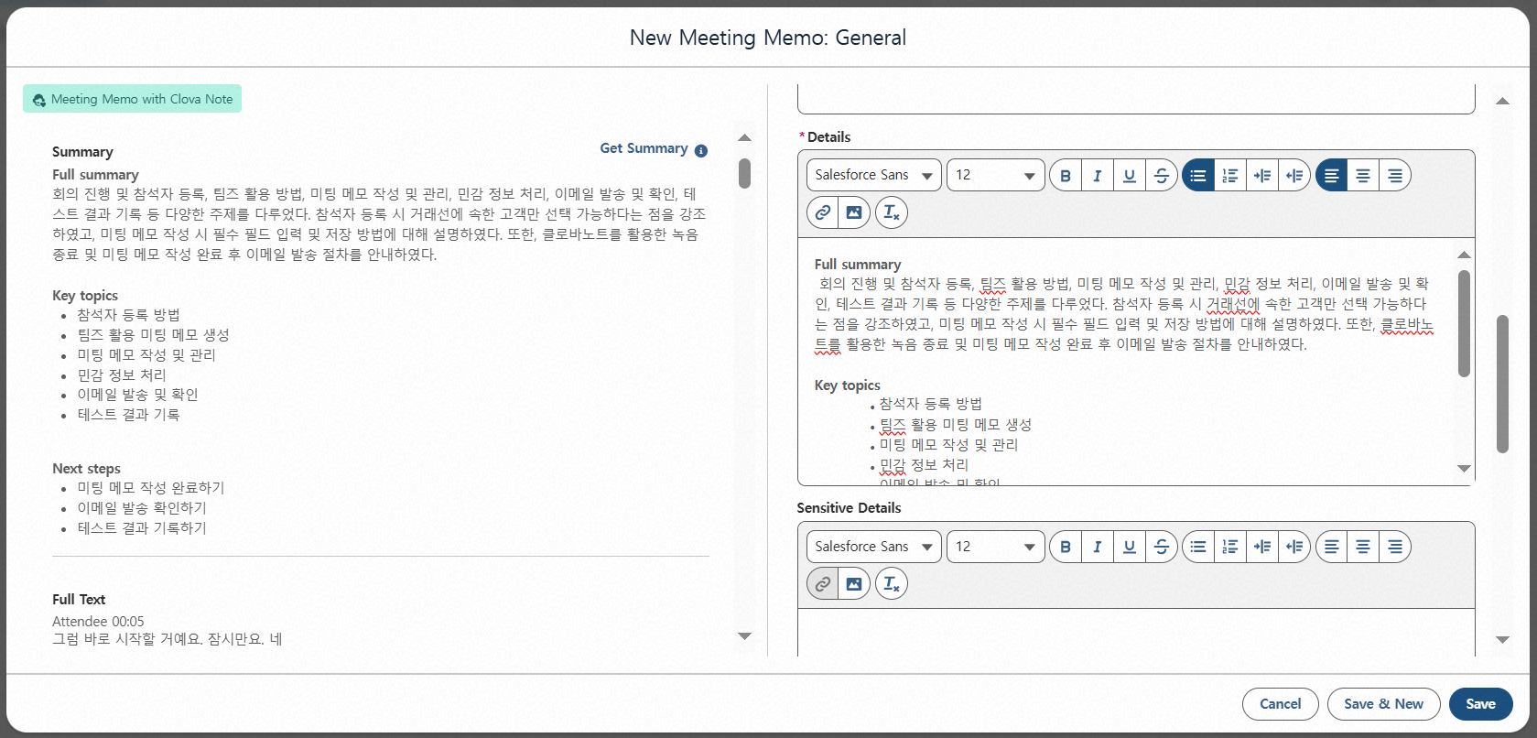
Step 1. Meeting Memo Creation
Step (Lv.2) | 1. Register New Meeting Memo | Step (Lv.3) | 1.1 Select Record Type_1.1.1 Use CLOVA Note
Menu | Meeting Memo | User | All Employees
Navigation | Home > Meeting Memo Menu > New Meeting Memo Popup
Review Summary and Full Transcript - Review the summary and full transcript of the meeting record selected in View Details
Click Get Summary to copy the summary into the Details section on the right-hand side of the Meeting Memo
When clicking Save, both the summary and full transcript displayed on the left screen are saved together - For detailed information, refer to P.29
1
2
3

Slide 9
Step 1. Meeting Memo Creation
Step (Lv.2) | 1. Register New Meeting Memo | Step (Lv.3) | 1.1 Select Record Type_1.1.2 Use Teams
Menu | Meeting Memo | User | All Employees
Navigation | Home > Meeting Memo Menu > New Meeting Memo Popup
Click Create New
Select Create Meeting Memo Using Microsoft Teams
Click Next
1
2
3
FAQ
Q. Can I still create a Meeting Memo without using the AI solution?
A. Yes. By selecting Basic Meeting Memo, you can create a Meeting Memo using the previous method.

Slide 10
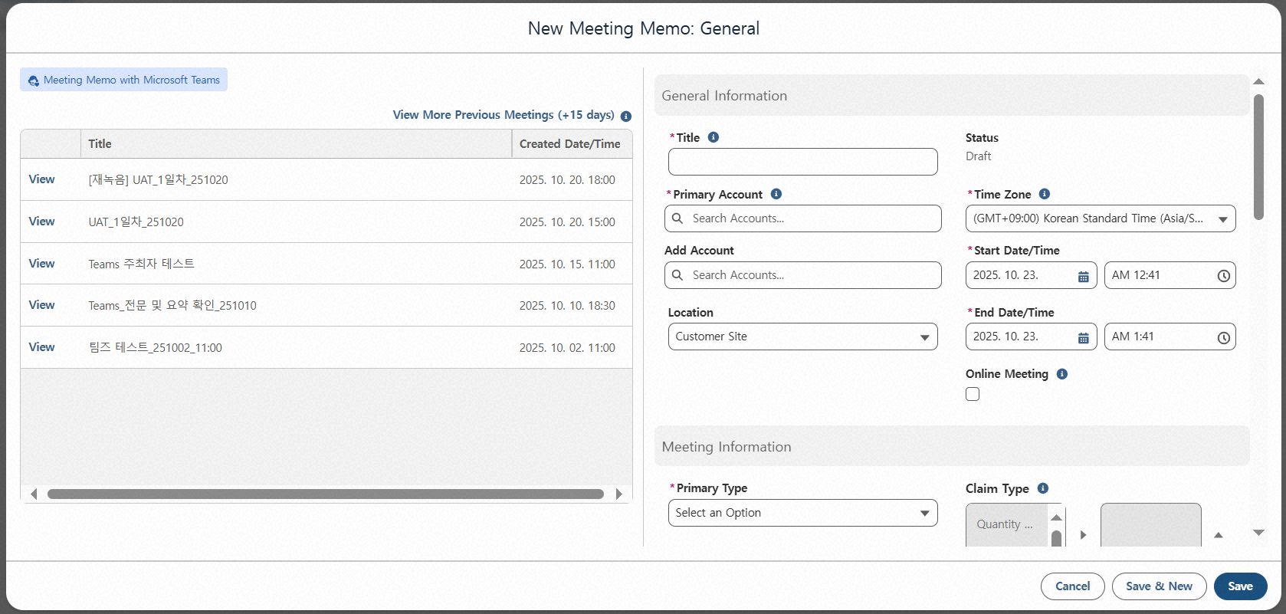
Step 1. Meeting Memo Creation
Step (Lv.2) | 1. Register New Meeting Memo | Step (Lv.3) | 1.1 Select Record Type_1.1.2 Use Teams
Menu | Meeting Memo | User | All Employees
Navigation | Home > Meeting Memo Menu > New Meeting Memo Popup
Check Created Teams Meeting Records - Lists meeting records created within the last 15 days - Meeting records can be viewed only if the meeting was created via “New Event” or from the Teams calendar screen (records from meetings started or joined via the “Start Meeting Now” button are not retrievable) - Records are accessible only if you created the meeting or were pre-registered as an attendee (unregistered participants cannot view the record) - For details, refer to P.90
1

Slide 11
Step 1. Meeting Memo Creation
Step (Lv.2) | 1. Register New Meeting Memo | Step (Lv.3) | 1.1 Select Record Type_1.1.2 Use Teams
Menu | Meeting Memo | User | All Employees
Navigation | Home > Meeting Memo Menu > New Meeting Memo Popup
(If needed) Click View More Previous Meetings - Lists meetings created within the last 15 days - By clicking View More, you can view meetings created up to the past 60 days
Click View Details for the meeting record you wish to use in the memo
1
2
FAQ
Q. I attended and recorded a Teams meeting, but the record doesn’t appear.
A. Using the “Start Meeting Now” button will not appear in the Meeting Memo. For details, refer to [Appendix] Teams Meeting Record Creation.

Slide 12
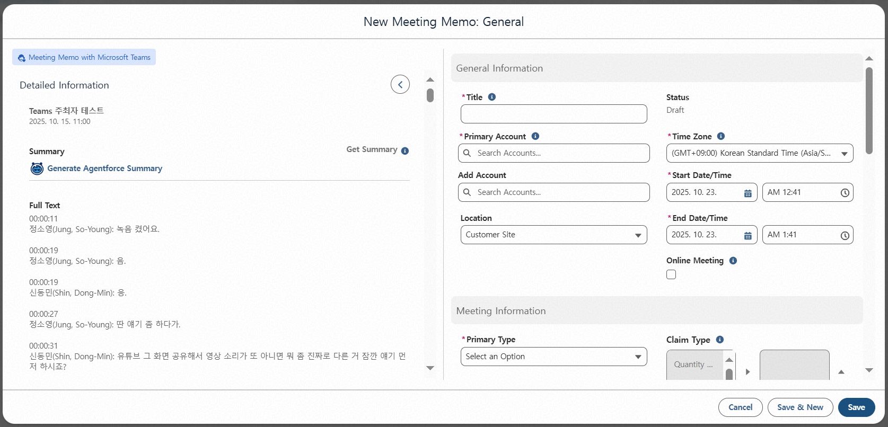
Step 1. Meeting Memo Creation
Step (Lv.2) | 1. Register New Meeting Memo | Step (Lv.3) | 1.1 Select Record Type_1.1.2 Use Teams
Menu | Meeting Memo | User | All Employees
Navigation | Home > Meeting Memo Menu > New Meeting Memo Popup
Click Generate Agentforce Summary
1

Slide 13
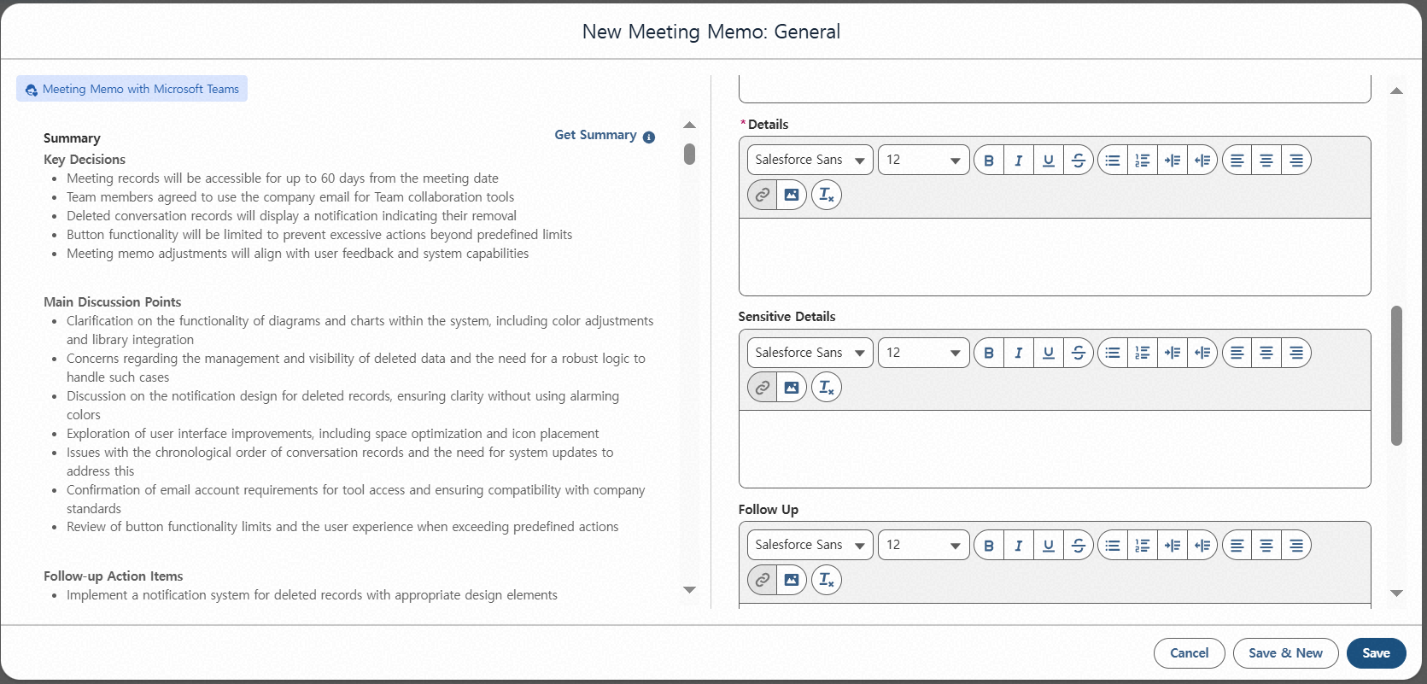
Step 1. Meeting Memo Creation
Step (Lv.2) | 1. Register New Meeting Memo | Step (Lv.3) | 1.1 Select Record Type_1.1.2 Use Teams
Menu | Meeting Memo | User | All Employees
Navigation | Home > Meeting Memo Menu > New Meeting Memo Popup
Review Generated Summary
Click Get Summary to copy the summary into the Details section of the Meeting Memo
When clicking Save, both the summary and full transcript displayed on the left screen are saved together - For detailed information, refer to P.29
1
2
FAQ
Q. Why is the summary copied to the Details section instead of the Summary section?
A. The summaries generated from recordings longer than 30–60 minutes are most similar in length and detail to what users typically write in the Details section.

Slide 14
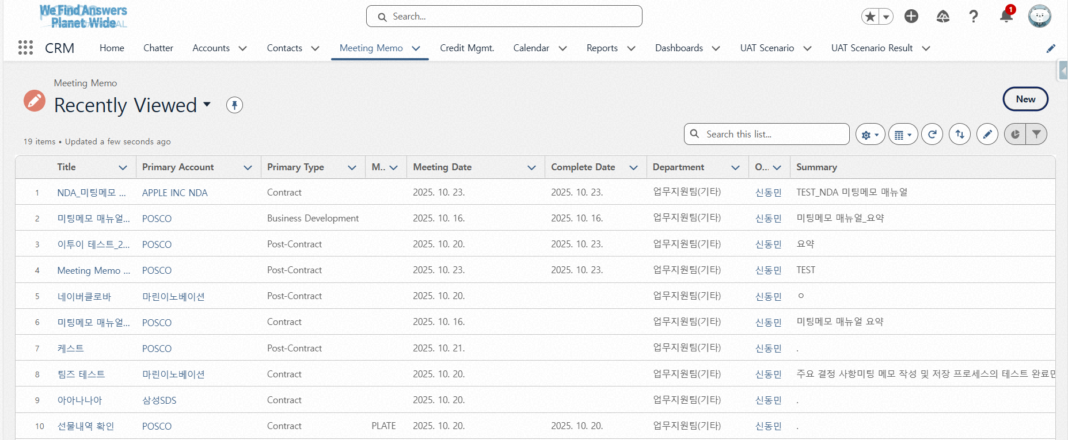
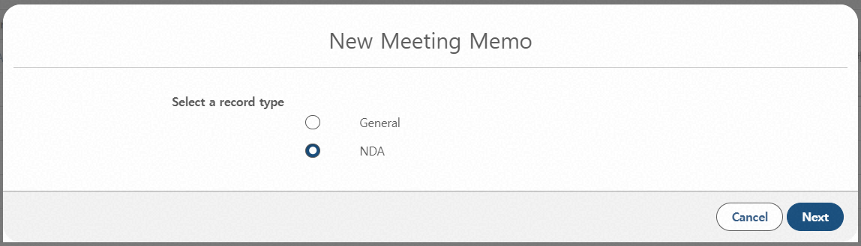
Step 1. Meeting Memo Creation
Step (Lv.2) | 1. Register New Meeting Memo | Step (Lv.3) | 1.1 Select Record Type_1.1.3 NDA Account
Menu | Meeting Memo | User | NDA Account Memo Access Manager
Navigation | Home > Meeting Memo Menu > New Meeting Memo Popup
Click Create New
Select NDA - Select “General” when creating a Meeting Memo for non-NDA accounts
Click Next
1
2
3
FAQ
Q. What’s the difference between NDA and General record types?
A. [Creation] NDA Meeting Memos can only be created by designated access managers. [Access] Only the author, their direct supervisor, and members explicitly granted view/edit permissions by the author can search or view the memo. [Features] NDA Meeting Memos include a separate permission setting for memo access, but do not support Sensitive Info writing/sharing or Email Send functions.
The NDA record type selection input is visible only to designated NDA account access managers. (It is not displayed to general users)

Slide 15
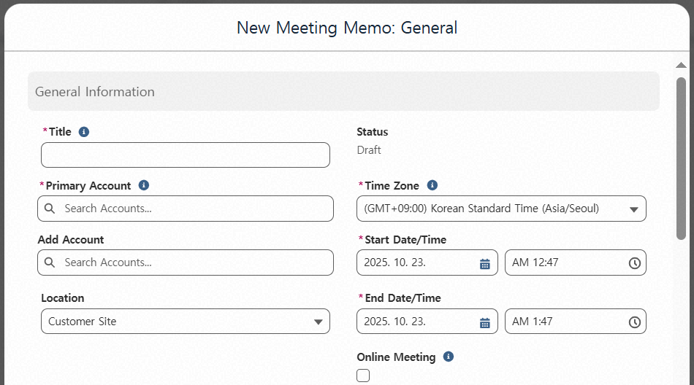
Step 1. Meeting Memo Creation
Step (Lv.2) | 1. Register New Meeting Memo | Step (Lv.3) | 1.2 Entering Basic Information
Menu | Meeting Memo | User | All Employees
Navigation | Home > Meeting Memo Menu > New Meeting Memo Popup
Click Create New
Enter Title (Required) - Up to 50 characters allowed
Register Primary Account (Required) - If only one client participated, enter that account - If multiple clients participated, enter the key account based on the agenda
Add Additional Accounts - You can register additional clients if two or more attended - New client entries and multiple selections are supported
※ Record Type NDA : Meeting Memo can only be saved if it includes at least one NDA account. Once an NDA account is registered, any number of general accounts can be added. Regardless of record type, the memo structure and fields remain the same
1
2
3
4

Slide 16
Step 1. Meeting Memo Creation
Step (Lv.2) | 1. Register New Meeting Memo | Step (Lv.3) | 1.2 Entering Basic Information
Menu | Meeting Memo | User | All Employees
Navigation | Home > Meeting Memo Menu > New Meeting Memo Popup
Select Time Zone (Required) - Defaults to the user’s configured standard time zone - Change only when attending a meeting in a different region (e.g., business trip); meeting date/time entered will not be affected by the change
Set Start/End Date and Time (Required) - Selecting or changing the start date automatically sets the end date to the same day - Selecting a start time automatically sets the end time to one hour later - Meeting date/time appears the same globally, regardless of time zone
1
2

Slide 17
Step 1. Meeting Memo Creation
Step (Lv.2) | 1. Register New Meeting Memo | Step (Lv.3) | 1.2 Entering Basic Information
Menu | Meeting Memo | User | All Employees
Navigation | Home > Meeting Memo Menu > New Meeting Memo Popup
Select Location - Choose from Headquarters, Client, or Other - Headquarters: Automatically fills in the main office address upon saving - Client: Automatically uploads the saved address of the registered Primary Account - Other: Enter address manually
Select Online Meeting Option - Choose if the meeting was conducted via video conference or conference call
1
FAQ
2
Q. Can I modify part of the address after selecting Headquarters or Client?
A. Yes. The address can be modified after saving the Meeting Memo.

Slide 18
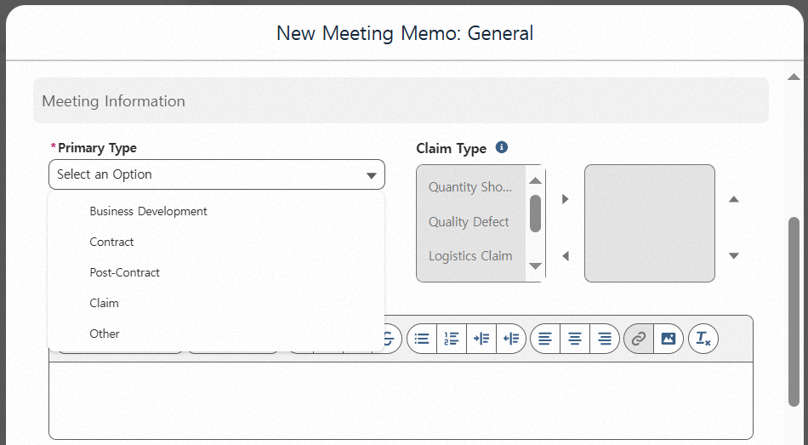
Step 1. Meeting Memo Creation
Step (Lv.2) | 1. Register New Meeting Memo | Step (Lv.3) | 1.3 Entering Meeting Information
Menu | Meeting Memo | User | All Employees
Navigation | Home > Meeting Memo Menu > New Meeting Memo Popup
Select Meeting Type (Required) - Choose one primary type that best represents the meeting: 1) New Business Proposal 2) Contract Discussion 3) Post-Contract Management 4) Claim 5) Others (e.g. Market trends)
Select Claim Type (Required) - Only required if “Claim” is selected as the meeting type - Not available for other meeting types - Multiple selections allowed: Quantity Shortage, Quality Defect, Logistics Claim, Production Delay, Others
1
2

Slide 19
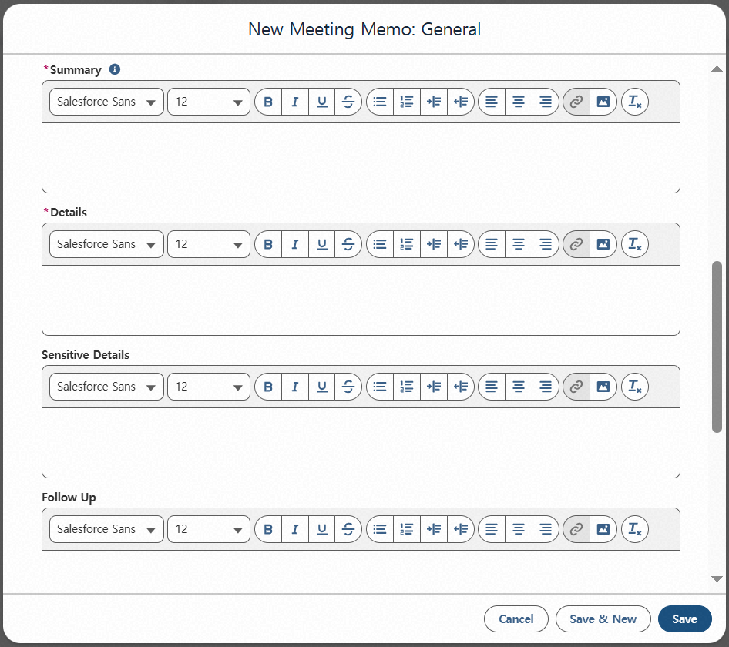
Step 1. Meeting Memo Creation
Step (Lv.2) | 1. Register New Meeting Memo | Step (Lv.3) | 1.3 Entering Meeting Information
Menu | Meeting Memo | User | All Employees
Navigation | Home > Meeting Memo Menu > New Meeting Memo Popup
Enter Summary (Required)
Enter Details (Required) - Information entered here is shared company-wide
Enter Sensitive Information - Enter any content that could pose issues if disclosed externally - Only users specified in “Sensitive Info Access” and their organization heads (per HR org chart) can view this information - Example: If belonging to A Division – B Department – C Group – D Section, both the designated users and leaders (D Section Head, C Group Head, B Department Head, A Division Head) can view - Up to 250 characters allowed (to prevent excessive sensitive data in Details; images/tables are not counted)
1
2
3

Slide 20
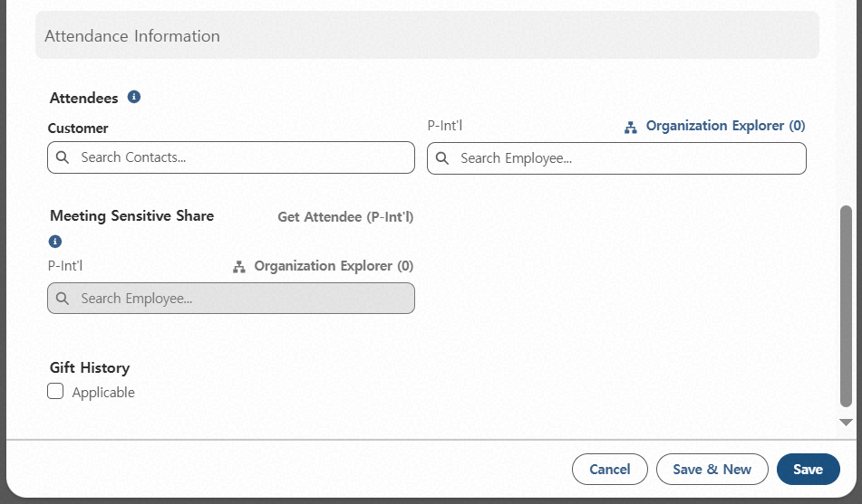
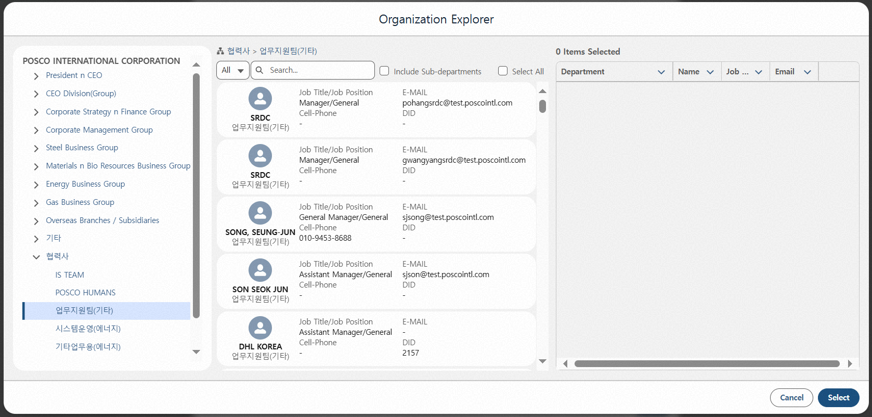
Step 1. Meeting Memo Creation
Step (Lv.2) | 1. Register New Meeting Memo | Step (Lv.3) | 1.4 Entering Attendance Information
Menu | Meeting Memo | User | All Employees
Navigation | Home > Meeting Memo Menu > New Meeting Memo Popup
Enter Client Attendees - Only contacts registered under Primary Account or Additional Accounts can be added - If a contact is not searchable, check whether they are registered under the client account
Enter Internal Attendees - All employees can be registered regardless of CRM account ownership
Click Organization Chart to add department-level participants or view employee info
Click Include Sub-departments to select all sub-levels of the chosen department
Click Select All to add all members of the chosen department
1
2
3
4
5

Slide 21
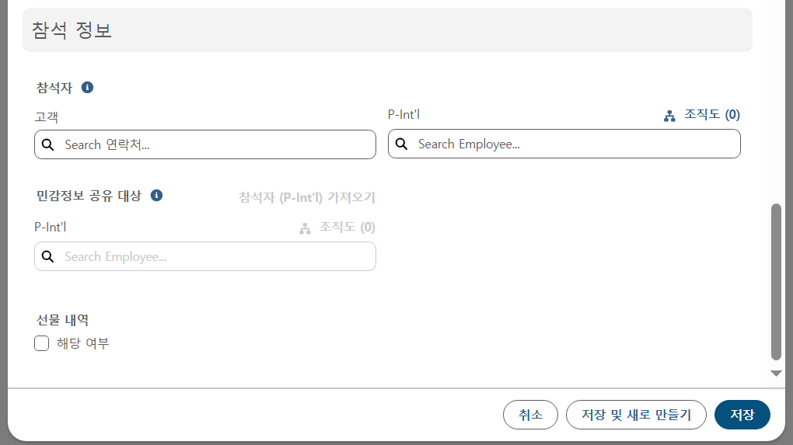
Step 1. Meeting Memo Creation
Step (Lv.2) | 1. Register New Meeting Memo | Step (Lv.3) | 1.4 Entering Attendance Information
Menu | Meeting Memo | User | All Employees
Navigation | Home > Meeting Memo Menu > New Meeting Memo Popup
Enter Sensitive Info Access List - Available only when sensitive information is entered - Registered members can view sensitive information - Only users with CRM accounts can be searched and added
Import Attendees (P-Int’l) - Click to bulk register internal attendees (with CRM accounts) as sensitive info viewers - Example: Internal attendees A, B, C, D, E (only A, B, C have CRM accounts)→ A, B, C are registered
1
2
2
2
FAQ
Q. Some employees don’t appear in the Sensitive Info Access search.
A. Sensitive information can only be viewed in CRM; therefore, only users with CRM accounts appear in the search list.

Slide 22
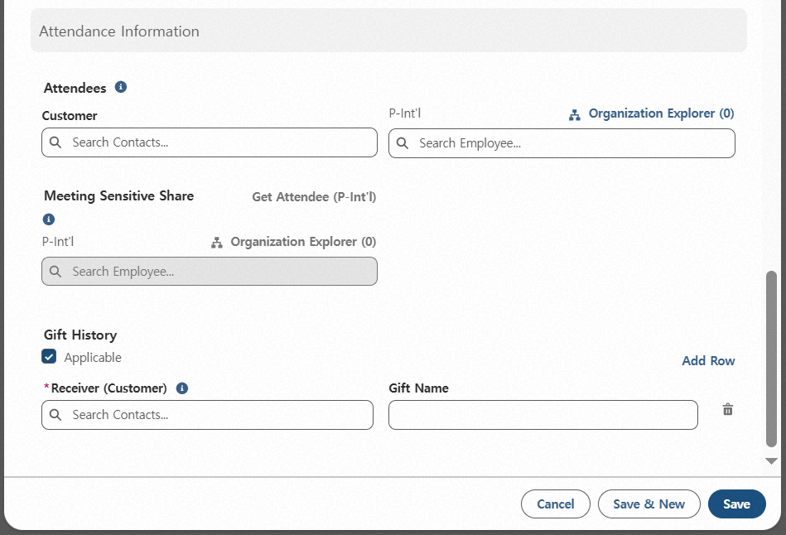
Step 1. Meeting Memo Creation
Step (Lv.2) | 1. Register New Meeting Memo | Step (Lv.3) | 1.4 Entering Attendance Information
Menu | Meeting Memo | User | All Employees
Navigation | Home > Meeting Memo Menu > New Meeting Memo Popup
Gift Record Applicable - Select if any client attendees received gifts
Enter Gift Recipients and Gift Details - Click (①) to open input fields - Enter recipients (only those registered as attendees can be selected) - Manually enter the gift name
Multiple Recipients or Gifts - Click Add Row to add more recipients or gifts in the same manner
1
3
2

Slide 23
Step 1. Meeting Memo Creation
Step (Lv.2) | 1. Register New Meeting Memo | Step (Lv.3) | 1.5 Save and Submit
Menu | Meeting Memo | User | All Employees
Navigation | Home > Meeting Memo Menu > New Meeting Memo Popup
Click to Temporarily Save and Create New - Saves the current Meeting Memo as a draft and opens a new creation screen
Click to Temporarily Save - Saves the current Meeting Memo as a draft and opens the detail view
※ Even after saving, the Meeting Memo is not shared company-wide; it remains visible only to the author in Draft status.
FAQ
Q. How long can I keep a draft saved?
A. There is no time limit for drafts, but for timely sharing, please complete and submit as soon as possible.
1
2

Slide 24
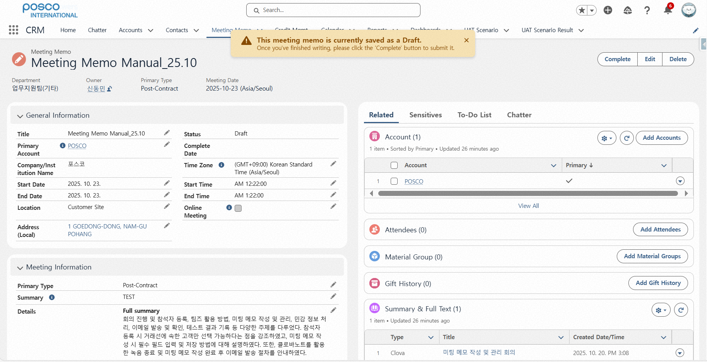
Step 1. Meeting Memo Creation
Step (Lv.2) | 1. Register New Meeting Memo | Step (Lv.3) | 1.5 Save and Submit
Menu | Meeting Memo | User | All Employees
Navigation | Home > Meeting Memo Menu > New Meeting Memo Popup > Detailed Page
Click Complete to finalize and register the Meeting Memo (Company-wide Sharing) - Clicking completes and shares the Meeting Memo company-wide - Until completion, only the author can view it - Email delivery and URL copy features become available after completion
※ A Meeting Memo is only shared company-wide when Complete is clicked. Before completion, it is visible only to the author.
1
FAQ
Q. The Delete button is not visible after completion. How can I delete it?
A. Completed Meeting Memos cannot be deleted. Please use the Edit function instead.

Slide 25
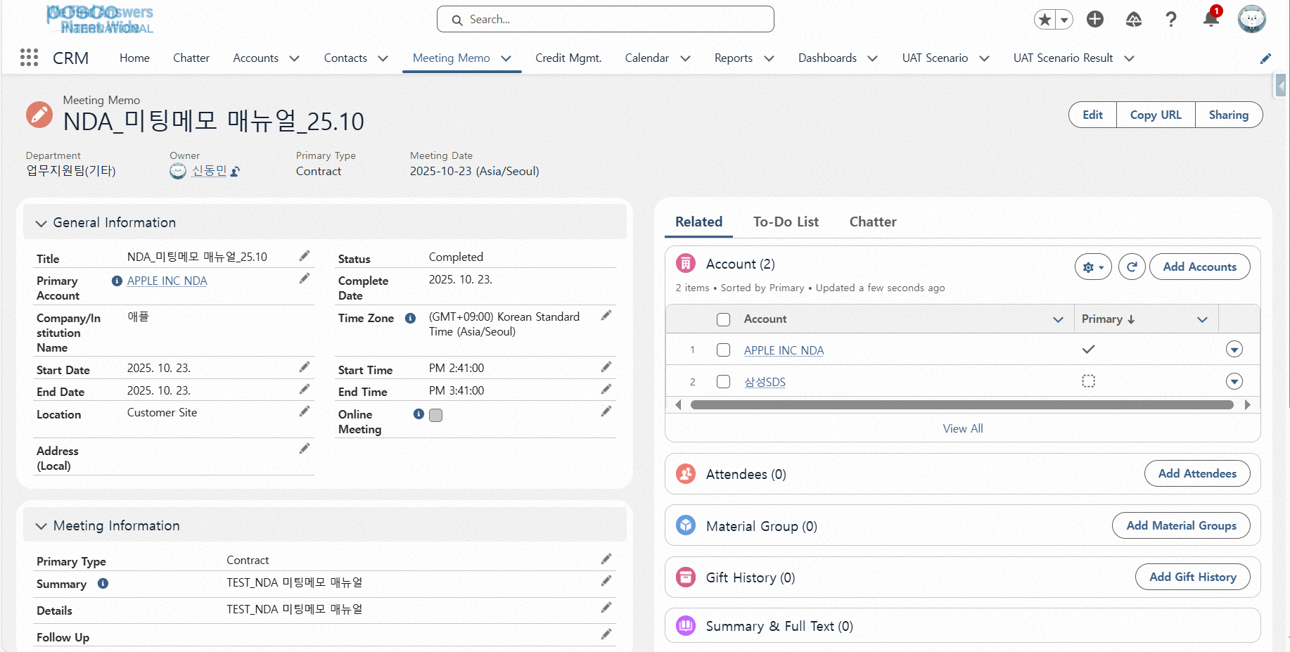
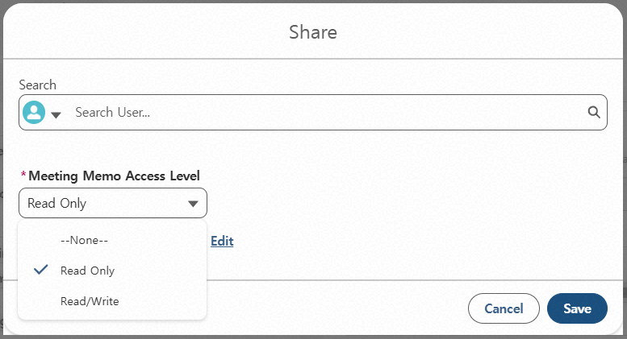
Step 1. Meeting Memo Creation
Step (Lv.2) | 1. Register New Meeting Memo | Step (Lv.3) | 1.5 Save and Submit
Menu | Meeting Memo | User | NDA Account Memo Access Manager
Navigation | Home > Meeting Memo Menu > New Meeting Memo Popup > Detailed Page
Click Sharing
Search and register members to share the NDA account Meeting Memo with
Select Meeting Memo Access Level - Default: Read-only - If Read/Write is selected, shared members can edit the Meeting Memo
※ Record Type NDA : After completion, the memo must be shared via the Share function for registered members to access it
1
2
3
FAQ
The above Sharing function applies only to Meeting Memos for NDA accounts. (It is not available for general account Meeting Memos)
Q. I don’t see the Share button.
A. The Share function for NDA account Meeting Memos becomes available only after the memo is completed.

Slide 26
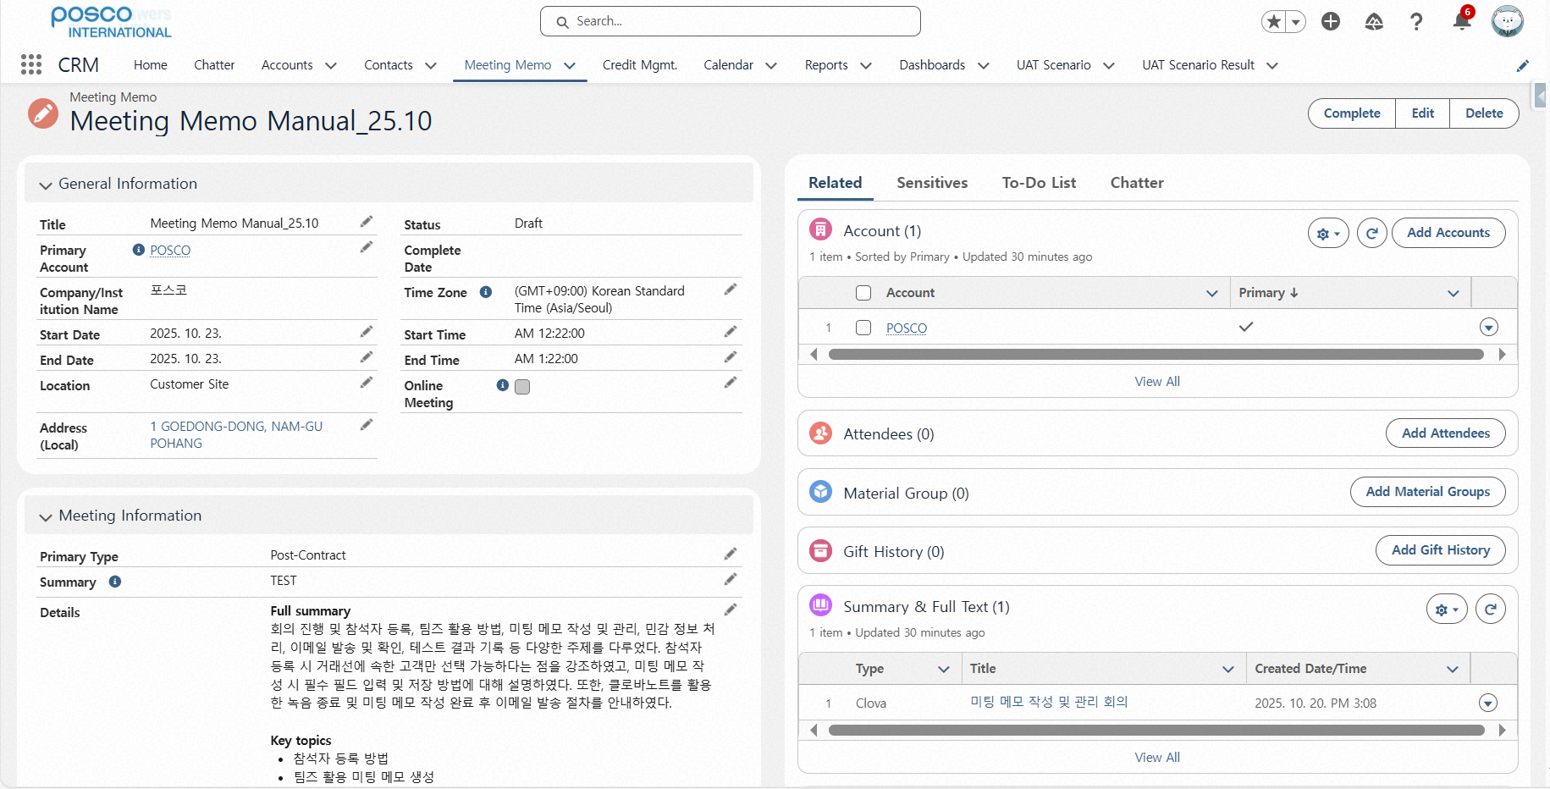
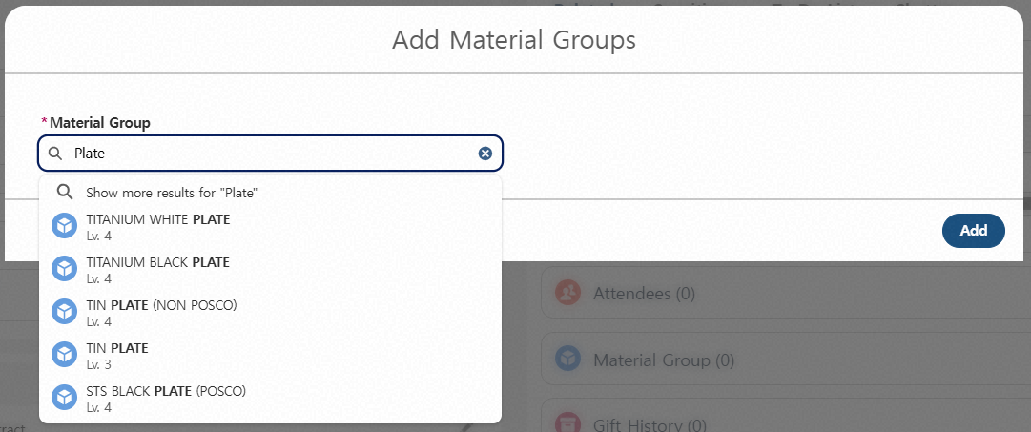
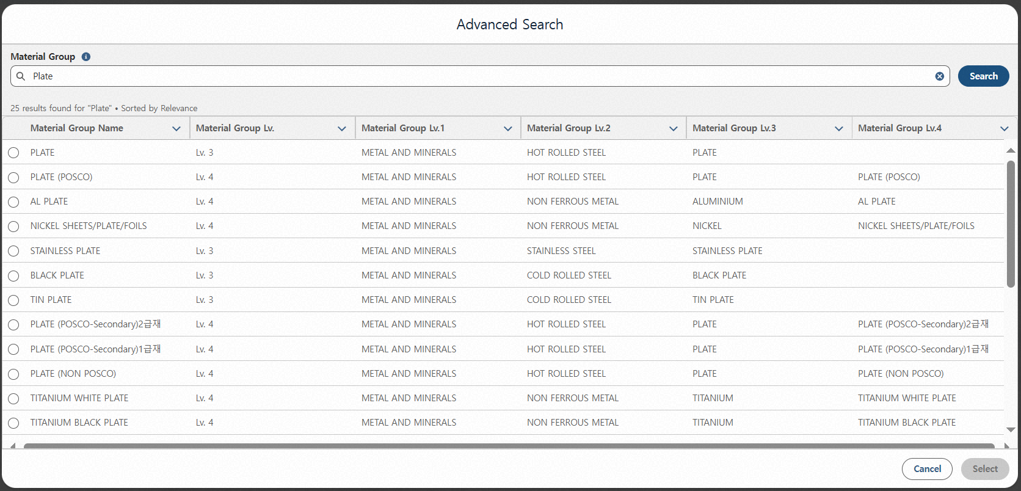
Step 1. Meeting Memo Creation
Step (Lv.2) | 1. Register New Meeting Memo | Step (Lv.3) | 1.6 Add Additional Information and Utilize Features
Menu | Meeting Memo | User | All Employees
Navigation | Home > Meeting Memo Menu > New Meeting Memo Popup > Detailed Page
Click Related Information (default view on detail page)
Click Add Product Item - Record and manage items discussed during the meeting - Can add Material Group Lv. 3 or 4
Search and select material name (multiple selections allowed) - Even partial keyword searches will display related items under Lv.3 or 4
Click to open Advanced Search in table view - Check Material Groups from Level 1 to 4
1
3
4
2
FAQ
Q. Can I add this information only after completion?
A. It can be added anytime during Draft status and within 30 days after completion (the period allowed for editing Meeting Memos).

Slide 27
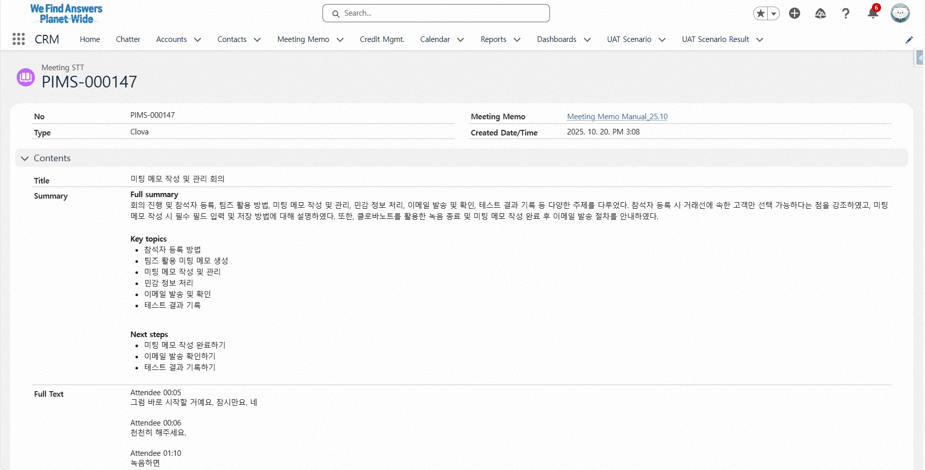
Step 1. Meeting Memo Creation
Step (Lv.2) | 1. Register New Meeting Memo | Step (Lv.3) | 1.6 Add Additional Information and Utilize Features
Menu | Meeting Memo | User | All Employees
Navigation | Home > Meeting Memo Menu > New Meeting Memo Popup > Detailed Page
Click Related Information (default view on detail page)
Review Summary and Full Transcript Section - When creating a Meeting Memo via CLOVA Note or Teams, summaries and transcripts viewed during temporary save are automatically stored
Click the title to view the full saved summary and transcript
1
2
3
FAQ
Q. The summary and transcript are missing.
A. Summaries and transcripts are only saved when the Meeting Memo is created using CLOVA Note or Teams. Please note that the specific record being viewed in Detail View at the time of clicking Temporary Save is the one that gets stored.

Slide 28
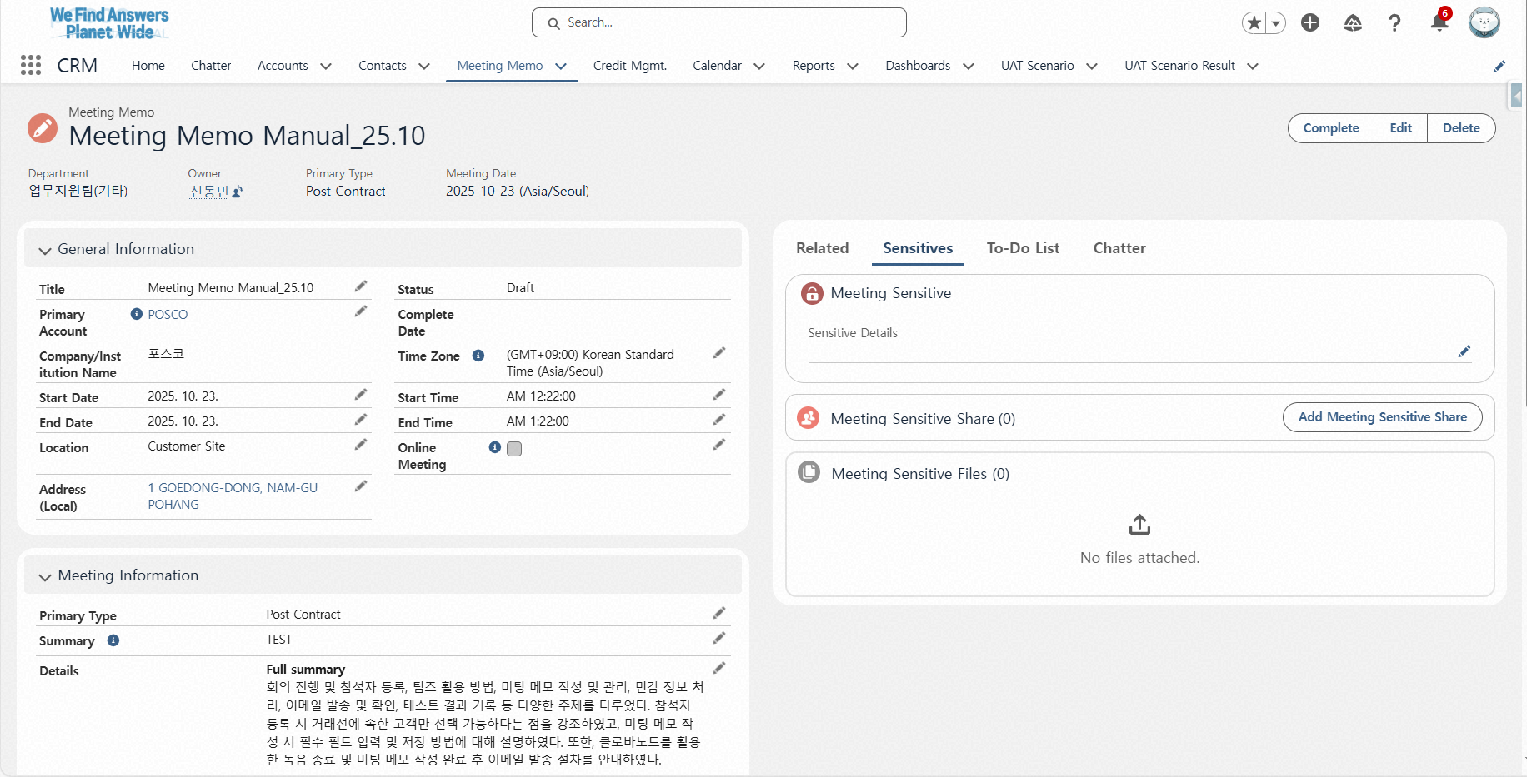
Step 1. Meeting Memo Creation
Step (Lv.2) | 1. Register New Meeting Memo | Step (Lv.3) | 1.6 Add Additional Information and Utilize Features
Menu | Meeting Memo | User | All Employees
Navigation | Home > Meeting Memo Menu > New Meeting Memo Popup > Detailed Page
Click Sensitive Information
Upload Sensitive Information File - Expands sharing method beyond text-based sensitive information to include file uploads
1
2
FAQ
Q. Who can view uploaded sensitive information files?
A. Files are shared only with members registered in the “Sensitive Info Access List,” same as text-based sensitive information. (Direct supervisors such as Group Heads, Team Leaders, and Division Heads can view even if not registered)

Slide 29
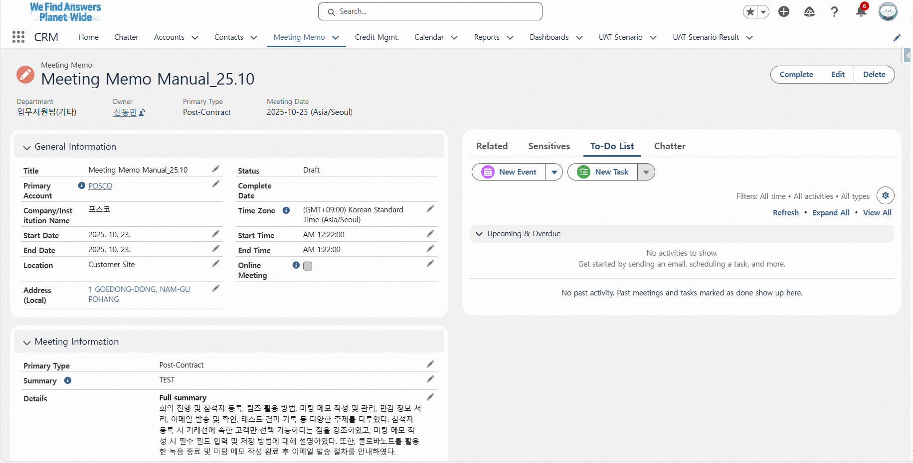
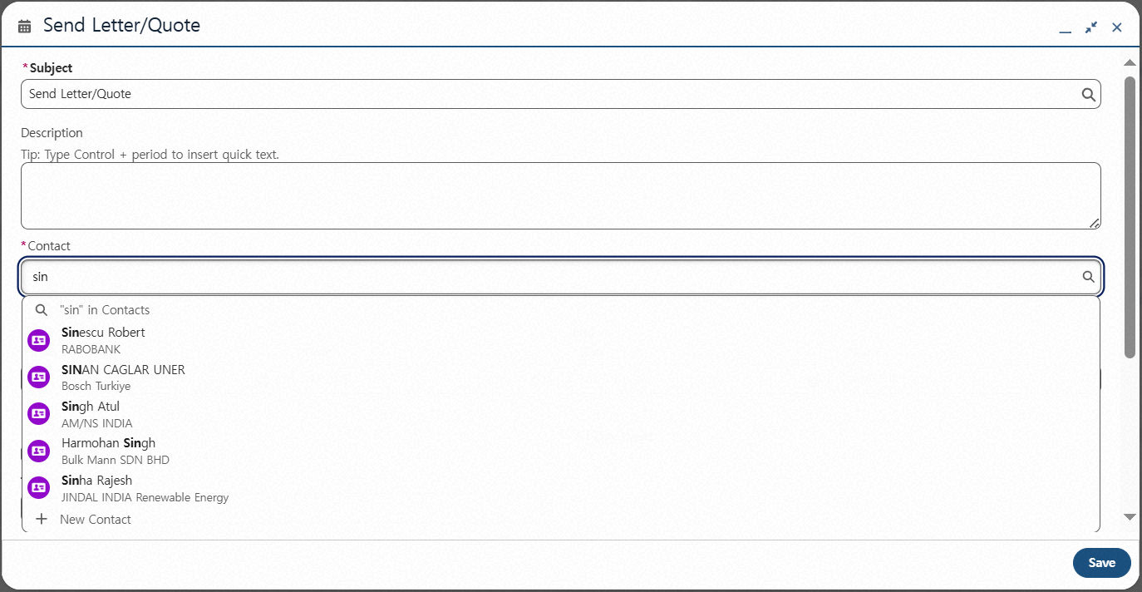
Step 1. Meeting Memo Creation
Step (Lv.2) | 1. Register New Meeting Memo | Step (Lv.3) | 1.6 Add Additional Information and Utilize Features
Menu | Meeting Memo | User | All Employees
Navigation | Home > Meeting Memo Menu > New Meeting Memo Popup > Detailed Page
Click To-Do List
Click New Event
Enter Event Title
Select Event Target (Client)Cannot save if selecting a client not registered in the Meeting Memo - Once saved, the event appears in the client’s Contact Detail page under “Activity” and in the client’s Account “Timeline” tab
1
2
3
4

Slide 30
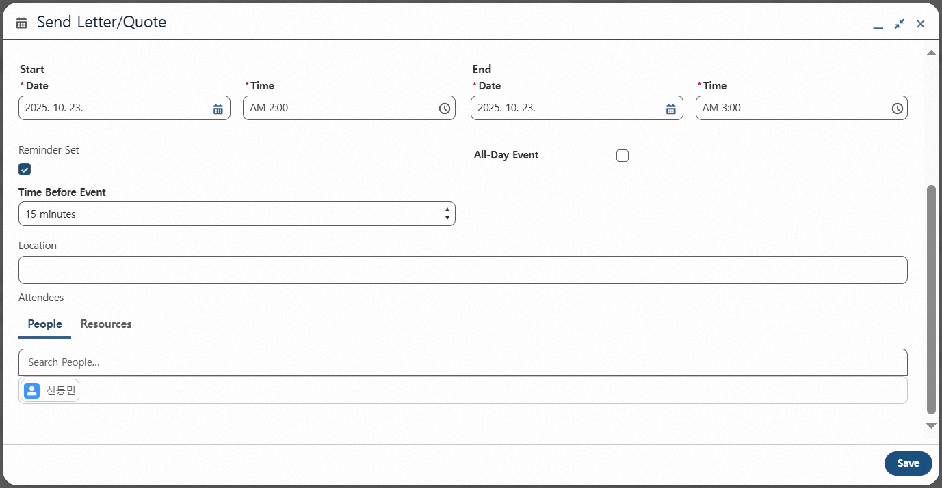
Step 1. Meeting Memo Creation
Step (Lv.2) | 1. Register New Meeting Memo | Step (Lv.3) | 1.6 Add Additional Information and Utilize Features
Menu | Meeting Memo | User | All Employees
Navigation | Home > Meeting Memo Menu > New Meeting Memo Popup > Detailed Page
Select Event Start/End Date and Time - Changing the start date automatically sets the end date to the same day - Selecting a start time automatically sets the end time to one hour later
(Optional) Set Reminder - Reminder can be set based on event start time - Reminder: Salesforce notification
(Optional) Register Event Attendees - Internal P-Intl members can be added - Event is automatically added to attendees’ Salesforce calendars
Click Save
1
2
3
4

Slide 31
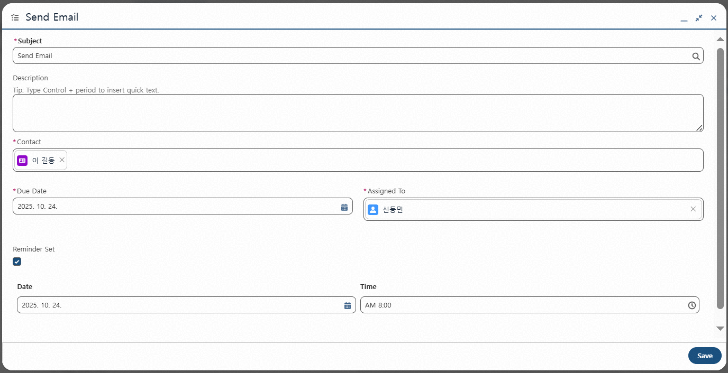
Step 1. Meeting Memo Creation
Step (Lv.2) | 1. Register New Meeting Memo | Step (Lv.3) | 1.6 Add Additional Information and Utilize Features
Menu | Meeting Memo | User | All Employees
Navigation | Home > Meeting Memo Menu > New Meeting Memo Popup > Detailed Page
Click New Task and Enter Title
Select Task Target (Client) - Cannot save if selecting a client not registered in the Meeting Memo - Once saved, the task appears in the client’s Contact Detail page under “Activity” and in the client’s Account “Timeline” tab
Select Due Date
Assign Responsible Person - Creator is assigned by default; can be changed - Upon reassignment and saving, email notification is sent to the new assignee
(Optional) Set Reminder
Click Save to create the task
1
1
2
3
4
5
6

Slide 32
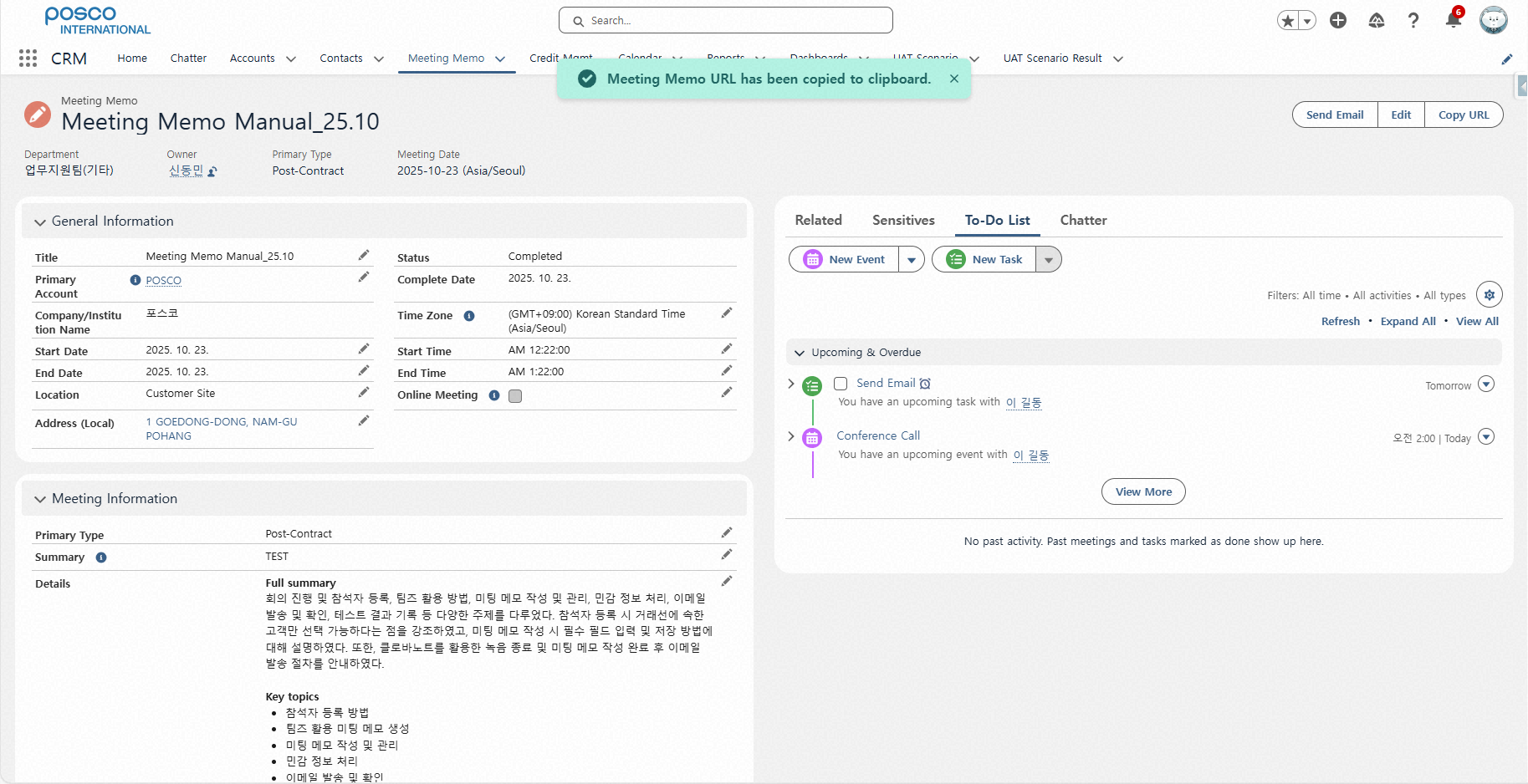
Step 1. Meeting Memo Creation
Step (Lv.2) | 1. Register New Meeting Memo | Step (Lv.3) | 1.6 Add Additional Information and Utilize Features
Menu | Meeting Memo | User | All Employees
Navigation | Home > Meeting Memo Menu > New Meeting Memo Popup > Detailed Page
Click Copy URL - Copies the Meeting Memo URL - Useful for attaching to travel expense reports, etc.
1

Slide 33
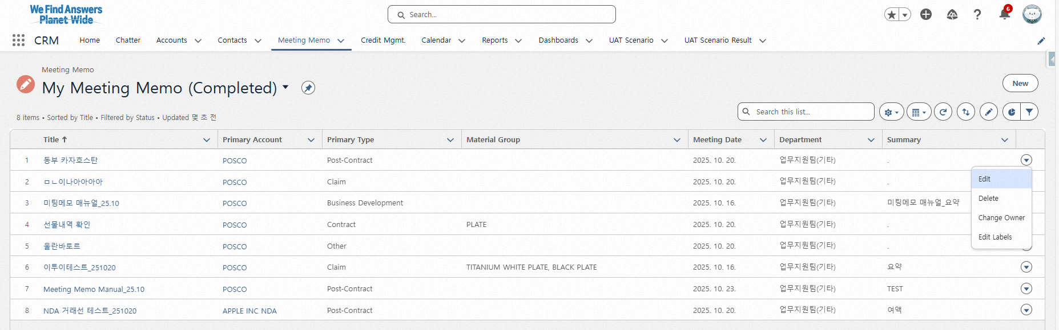
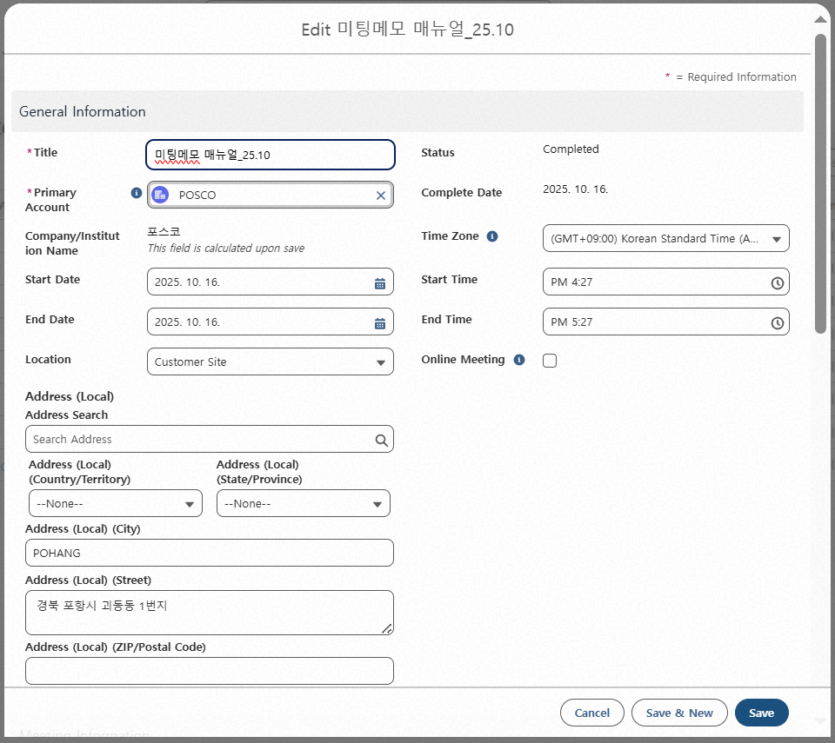
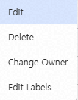
Step 1. Meeting Memo Creation
Step (Lv.2) | 2. Meeting Memo Editing | Step (Lv.3) | 2.1 Editing from the Meeting Memo List View
Menu | Meeting Memo | User | All Employees
Navigation | Home > Meeting Memo Menu > Listview Filter > Edit
Select List View Filter: My Meeting Memo (Completed)
Click the down arrow icon of the memo to edit
Opens edit popup for the selected Meeting Memo
Editable fields: all except Related Info and Sensitive Info - Related Info includes additional accounts, attendees, and gift records
※ Editable for 1 month after submission - No time limit for drafts
1
2
4
3
FAQ
Q. Can I edit after submission?
A. Yes, edits are allowed for 1 month after completion

Slide 34
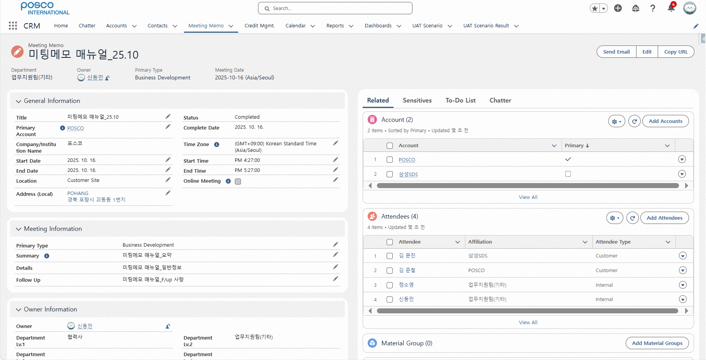
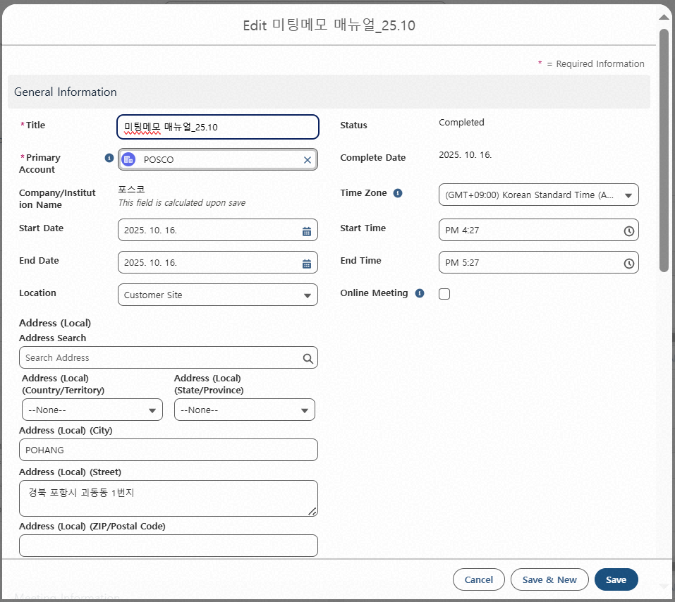
Step 1. Meeting Memo Creation
Step (Lv.2) | 2. Meeting Memo Editing | Step (Lv.3) | 2.2 Editing from the Meeting Memo Detail Page
Menu | Meeting Memo | User | All Employees
Navigation | Home > Meeting Memo Menu > Meeting Memo Detailed Page > Edit
Click Edit
Editable fields: all except Related Info and Sensitive Info - Related Info includes accounts, attendees, and gift records
1
2
FAQ
Q. How do I edit Sensitive Information?
A. Go to the “Sensitive Info” tab. See P.38 for details.

Slide 35

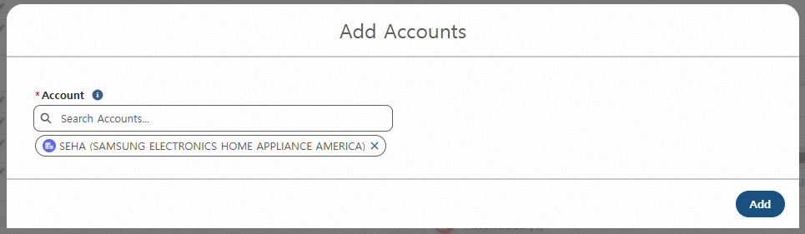
Step 1. Meeting Memo Creation
Step (Lv.2) | 2. Meeting Memo Editing | Step (Lv.3) | 2.2 Editing from the Meeting Memo Detail Page
Menu | Meeting Memo | User | All Employees
Navigation | Home > Meeting Memo Menu > Meeting Memo Detailed Page
Click pencil icon to edit - Basic and meeting information can be modified
In “Related” tab, click Add to include additional info - Can add account, attendee, and gift details
Click down arrow icon to delete
1
2
3

Slide 36
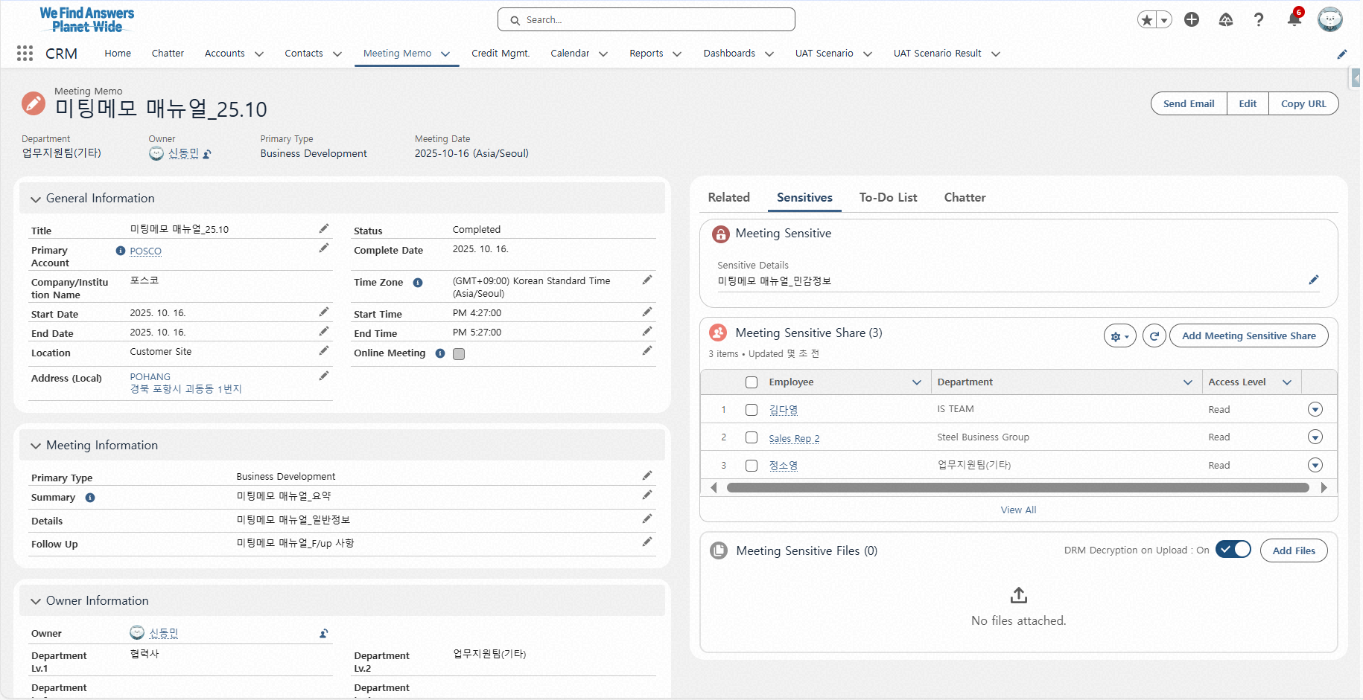
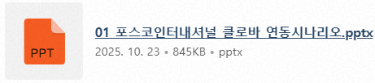
Step 1. Meeting Memo Creation
Step (Lv.2) | 2. Meeting Memo Editing | Step (Lv.3) | 2.2 Editing from the Meeting Memo Detail Page
Menu | Meeting Memo | User | All Employees
Navigation | Home > Meeting Memo Menu > Meeting Memo Detailed Page
Click Sensitive Info tab
Click pencil icon to edit sensitive information
Click Add Sensitive Info Access to add viewers
Click down arrow icon to remove viewers
Click Upload File to add sensitive info files - Files are viewable/downloadable only by registered Sensitive Info Access members
1
2
3
4
5

Slide 37
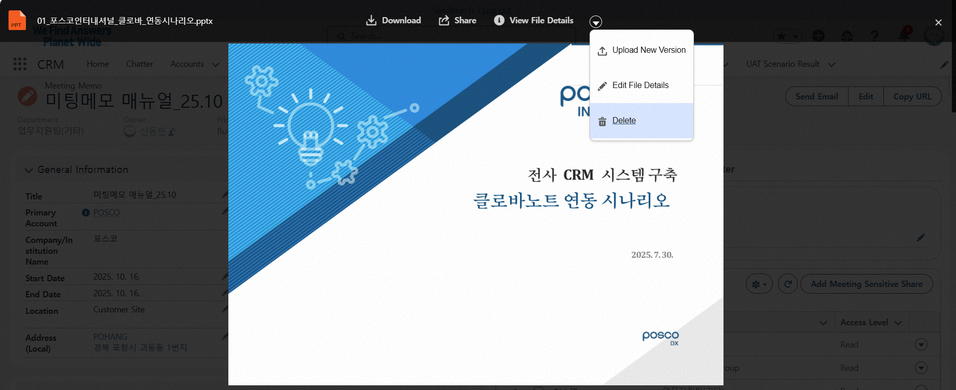
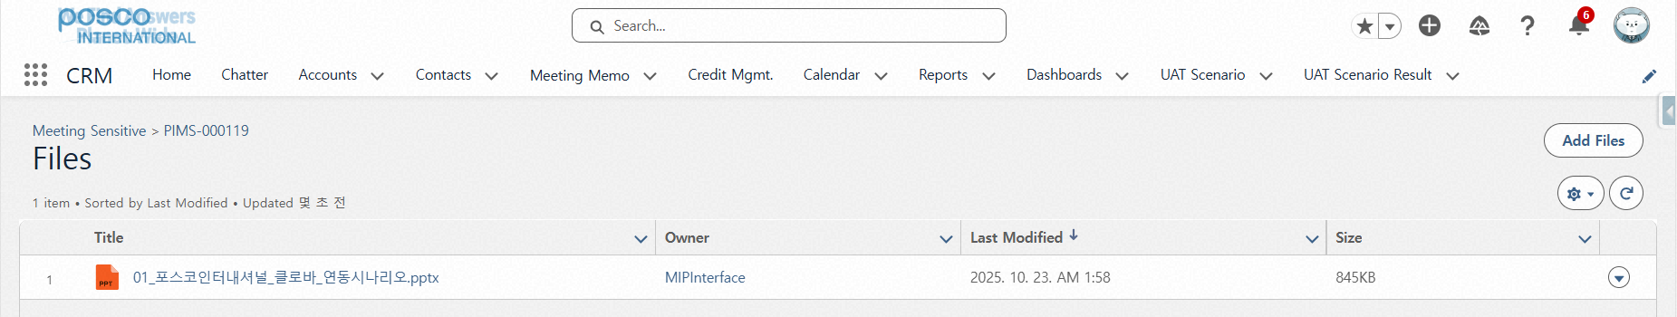
Step 1. Meeting Memo Creation
Step (Lv.2) | 2. Meeting Memo Editing | Step (Lv.3) | 2.2 Editing from the Meeting Memo Detail Page
Menu | Meeting Memo | User | All Employees
Navigation | Home > Meeting Memo Menu > Meeting Memo Detailed Page
[Edit Method 1] Click Sensitive Info File
Click down arrow icon to delete uploaded file
[Edit Method 2] Click View All
Click down arrow icon to delete uploaded file
2
1
3
4

Slide 38
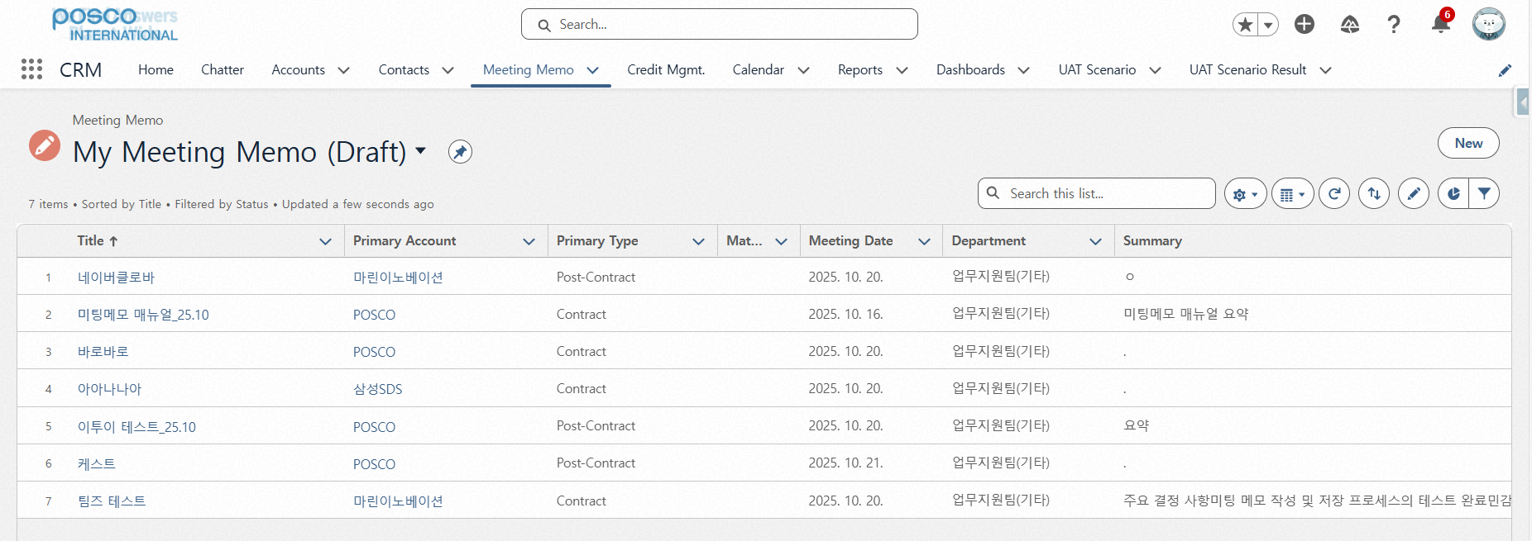
Step 2. Meeting Memo Saving / Submission
Step (Lv.2) | 1. Temporary Save and Submit | Step (Lv.3) | 1.1 Edit Draft Information and Submit
Menu | Meeting Memo | User | All Employees
Navigation | Home > Meeting Memo Menu > Listview Filter
Select List View Filter: My Meeting Memo (Draft) - Displays all Meeting Memos saved as drafts
Click the title in the “Title” column - Opens the Meeting Memo detail page
1
2

Slide 39
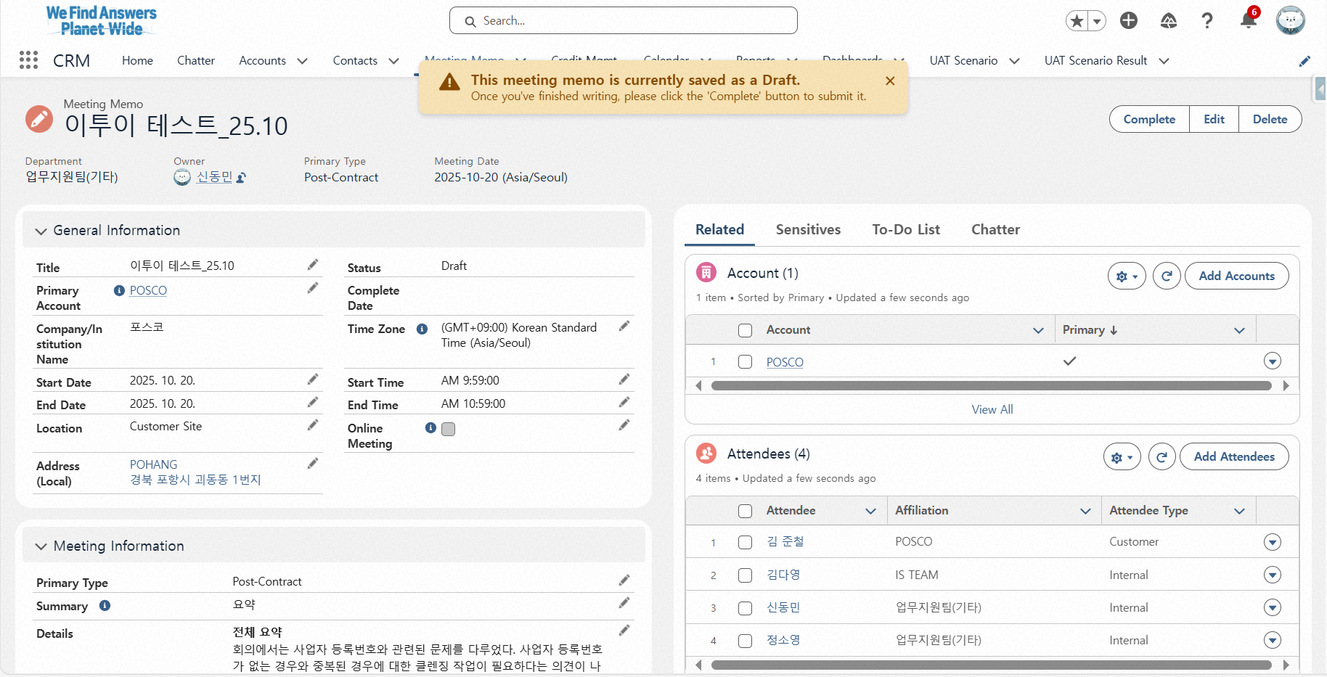
Step 2. Meeting Memo Saving / Submission
Step (Lv.2) | 1. Temporary Save and Submit | Step (Lv.3) | 1.1 Edit Draft Information and Submit
Menu | Meeting Memo | User | All Employees
Navigation | Home > Meeting Memo Menu > Meeting Memo Detailed Page
If needed, edit Meeting Memo and click Complete - For editing steps, refer to Step 1: Create Meeting Memo → Step 2: Edit Meeting Memo
1
FAQ
Q. Where is the Send Email button?
A. Available after clicking Complete. It appears in the same location as the Complete button.

Slide 40
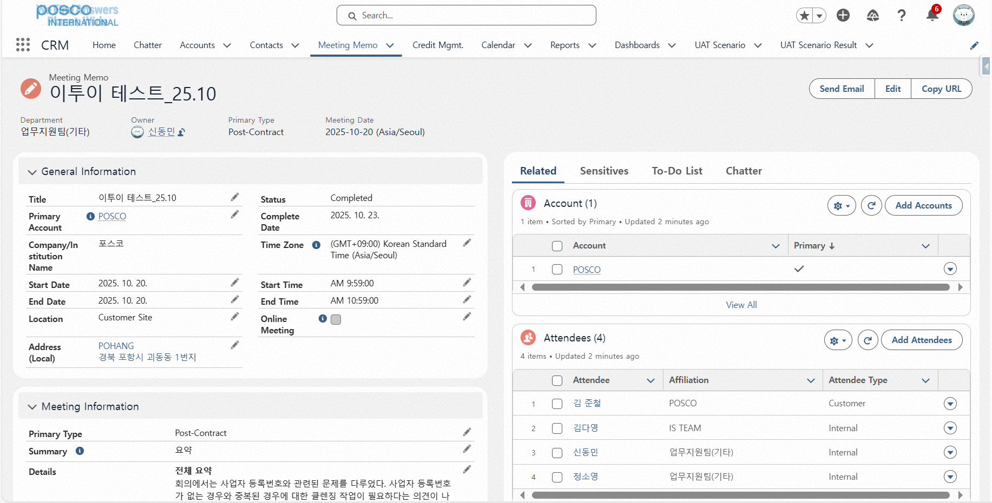
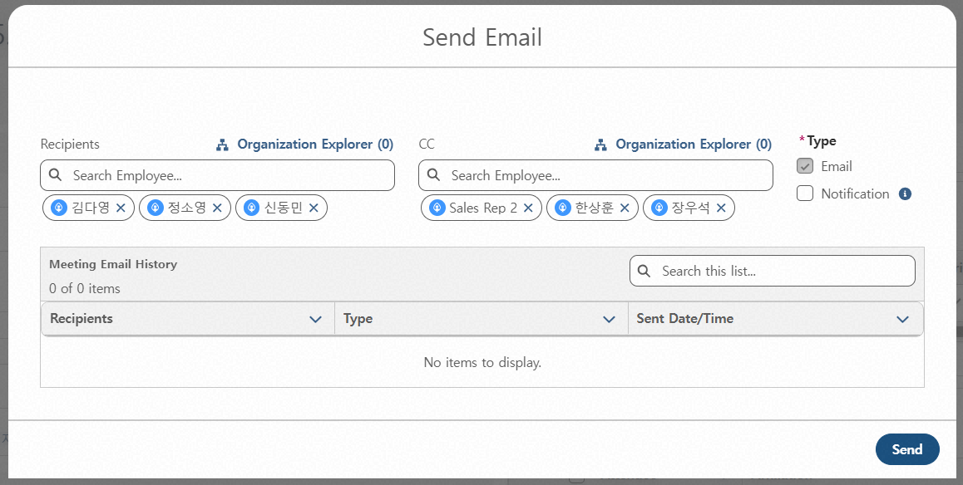
Step 2. Meeting Memo Saving / Submission
Step (Lv.2) | 2. Email and Notification Delivery | Step (Lv.3) | 2.1 Set Recipients / CC
Menu | Meeting Memo | User | All Employees
Navigation | Home > Meeting Memo Menu > Meeting Memo Detailed Page > Sending Email
Click Send Email
Set recipients/CC for email/notification - Use org chart modal to register by department - Up to 100 recipients per send (1) Recipients - Internal attendees registered in P-Int’l are auto-added (2) CC - Only members registered in Sensitive Info Access are auto-added - Example: Attendees_P-Int’l: A, B, C; Sensitive Info Access: A, B, C, D, E → D and E are added as CC
※ Notification: Bell alert in top-right of Salesforce
1
2

Slide 41
Step 2. Meeting Memo Saving / Submission
Step (Lv.2) | 2. Email and Notification Delivery | Step (Lv.3) | 2.1 Set Recipients / CC
Menu | Meeting Memo | User | All Employees
Navigation | Home > Meeting Memo Menu > Meeting Memo Detailed Page > Sending Email
Select Send Type (multiple options allowed) - Email is mandatory - Notification is optional - Can send both simultaneously
Click Send
※ Notification: Sent only to CRM users (Salesforce account holders) among selected recipients/CC
1
2

Slide 42

Step 2. Meeting Memo Saving / Submission
Step (Lv.2) | 2. Email and Notification Delivery | Step (Lv.3) | 2.2 Review Sending Template and History
Menu | Meeting Memo | User | All Employees
Navigation | EP > Inbox
Check received email (1) Subject Template - "<Main Account Name> + Meeting Memo Title + Meeting Date + Author’s Department Lv.3“ - If Lv.3 doesn’t exist, higher level is shown (2) Also includes account, attendees, meeting date, summary, general info, follow-up items, and gift records
Click to open Meeting Memo detail page - Only accessible to CRM account holders
Sensitive Info status displayed - If written = Y - If not written = N
Follow-up and gift sections are hidden if not filled
1
2
3
4

Slide 43


Step 2. Meeting Memo Saving / Submission
Step (Lv.2) | 2. Email and Notification Delivery | Step (Lv.3) | 2.2 Review Sending Template and History
Menu | Meeting Memo | User | All Employees
Navigation | Home > Meeting Memo Menu > Meeting Memo Detailed Page > Sending Email
Click Send Email
View email send history - Shows recipients, type (To/CC), and send time
Search email recipients - Useful for tracking after bulk sends
Click Send to resend email
1
2
3
FAQ
4
Q. Can I recall a sent email?
A. No, recall is not possible. EP mail integration is planned for future recall support.

Slide 44


Step 2. Meeting Memo Saving / Submission
Step (Lv.2) | 2. Email and Notification Delivery | Step (Lv.3) | 2.2 Review Sending Template and History
Menu | Meeting Memo | User | All Employees
Navigation | Home > Meeting Memo Menu > Meeting Memo Detailed Page > Sending Email
1
Click Salesforce Bell Notification
Check received Meeting Memo notification - Click title to open Meeting Memo detail page (1) Title Template : Author’s Department Lv.3 + Author Name + Meeting Memo Title (2) Content Template : Meeting Date, Main Account Name, Meeting Type
※ Notification: Sent only to CRM users (Salesforce account holders) among selected recipients/CC
2

Slide 45




Step 3. Meeting Memo View
Step (Lv.2) | 1. View Meeting Memo List | Step (Lv.3) | 1.1 View from Home Screen
Menu | Meeting Memo | User | All Employees
Navigation | Home
1
Click Home (default Salesforce landing page)
View latest Meeting Memos by organization - Shows memos created in user’s org within last 7 days - Org: Based on group; if unavailable, shows higher org
View user-created memos by day/week/month - Includes both draft and completed memos - Drafts appear at the top
View memos where user is recipient or CC
View memos created under user’s starred accounts
※ Click Meeting Memo title to open detail page (applies to ①–⑤)
2
3
4
5

Slide 46


Step 3. Meeting Memo View
Step (Lv.2) | 1. View Meeting Memo List | Step (Lv.3) | 1.2 Use Filters in List View to Search Meeting Memos
Menu | Meeting Memo | User | All Employees
Navigation | Home > Meeting Memo Menu > Listview Filter
Click List View Filter on left panel
Select filter to view memos based on conditions (1) Meeting Memo (Department) - Regular users: View memos created in their group - Team Leaders and above: View all memos created in subordinate orgs (2) My Meeting Memo (Completed) - View only submitted memos (3) My Meeting Memo (Draft) - View only draft memos
1
2

Slide 47


Step 3. Meeting Memo View
Step (Lv.2) | 2. View Detailed Meeting Memo | Step (Lv.3) | 2.1 View Related Information
Menu | Meeting Memo | User | All Employees
Navigation | Home > Meeting Memo Menu > Meeting Memo Detailed Page
View Related Info - Includes account, attendees, product items, gift records, summary, transcript, and attachments
Click View All in Related Info section to see full details
1
2

Slide 48

Step 3. Meeting Memo View
Step (Lv.2) | 2. View Detailed Meeting Memo | Step (Lv.3) | 2.2 View Sensitive Information and Sharing Targets
Menu | Meeting Memo | User | All Employees
Navigation | Home > Meeting Memo Menu > Meeting Memo Detailed Page > Sensitive Information
View Sensitive Info, Files, and Access List - Shows sensitive info, files, and access members for the memo - If no sensitive info written: “No sensitive information available” - If written but no access: “You do not have permission to view sensitive information” - If no access, cannot view access member list either
Click View All to see full access list - Up to 10 members shown without View All; 11+ requires View All
1
2

Slide 49

Step 3. Meeting Memo View
Step (Lv.2) | 2. View Detailed Meeting Memo | Step (Lv.3) | 2.3 View To-Do List
Menu | Meeting Memo | User | All Employees
Navigation | Home > Meeting Memo Menu > Meeting Memo Detailed Page > To-Do List
View To-Do List - Shows events and tasks created from the Meeting Memo
1

Slide 50
Contents_Mobile
Step 1
Meeting Memo Creation
Register New Meeting Memo 1.1 Select Record Type 1.1.1 Use CLOVA Note 1.1.2 Use Teams 1.1.3 NDA Account 1.2 Enter Basic Information 1.3 Enter Meeting Details 1.4 Enter Attendance Information 1.5 Save and Submit 1.6 Add Additional Information and Utilize Features
Meeting Memo Editing 2.1 Editing from the Meeting Memo List View 2.2 Editing from the Meeting Memo Detail Page

Slide 51
Contents_Mobile
Step 2
Meeting Memo Saving / Submission
Temporary Save and Submit 1.1 Edit Draft Information and Submit
Email and Notification Delivery 2.1 Set Recipients / CC 2.2 Review Sending Template and History
Step 3
Meeting Memo View
View Meeting Memo List 1.1 Use Filters in List View to Search Meeting Memos
View Detailed Meeting Memo 2.1 View Related Information 2.2 View Sensitive Information and Sharing Targets 2.3 View To-Do List

Slide 52


Step 1. Meeting Memo Creation
Step (Lv.2) | 1. Register New Meeting Memo | Step (Lv.3) | 1.1 Select Record Type_1.1.1 Use CLOVA Note
Menu | Meeting Memo | User | All Employees
Navigation | Home > Meeting Memo Menu > New Meeting Memo Popup
Click Create New
Select Create Meeting Memo Using CLOVA Note
Click Next
1
2
FAQ
3
Q. Can I create a Meeting Memo without using the AI solution, as before? A. Yes. By selecting Basic Meeting Memo, you can create a Meeting Memo using the previous method.

Slide 53

Step 1. Meeting Memo Creation
Step (Lv.2) | 1. Register New Meeting Memo | Step (Lv.3) | 1.1 Select Record Type_1.1.1 Use CLOVA Note
Menu | Meeting Memo | User | All Employees
Navigation | Home > Meeting Memo Menu > New Meeting Memo Popup
Check Created CLOVA Note Meeting Records - Lists meeting records created within the last 30 days - Only records created using the assigned business account are viewable after logging into CLOVA Note (records created with personal accounts are not accessible) - All records are listed regardless of whether they were created via CLOVA Note web or mobile
Click View Details for the record you want to use when creating a Meeting Memo - Among the summary and full transcript provided in View Details, the summary will not be available if it was not generated in CLOVA Note
1
2

Slide 54



Step 1. Meeting Memo Creation
Step (Lv.2) | 1. Register New Meeting Memo | Step (Lv.3) | 1.1 Select Record Type_1.1.1 Use CLOVA Note
Menu | Meeting Memo | User | All Employees
Navigation | Home > Meeting Memo Menu > New Meeting Memo Popup
Review Summary and Full Transcript - Review the summary and full transcript of the meeting record selected in View Details
Click Get Summary to copy the summary into the Details section on the right-hand side of the Meeting Memo
When clicking Save, both the summary and full transcript displayed on the left screen are saved together - For detailed information, refer to P.71
1
2
1
3

Slide 55


Step 1. Meeting Memo Creation
Step (Lv.2) | 1. Register New Meeting Memo | Step (Lv.3) | 1.1 Select Record Type_1.1.2 Use Teams
Menu | Meeting Memo | User | All Employees
Navigation | Home > Meeting Memo Menu > New Meeting Memo Popup
Click Create New
Select Create Meeting Memo Using Microsoft Teams
Click Next
1
2
FAQ
3
Q. Can I still create a Meeting Memo without using the AI solution?
A. Yes. By selecting Basic Meeting Memo, you can create a Meeting Memo using the previous method.

Slide 56

Step 1. Meeting Memo Creation
Step (Lv.2) | 1. Register New Meeting Memo | Step (Lv.3) | 1.1 Select Record Type_1.1.2 Use Teams
Menu | Meeting Memo | User | All Employees
Navigation | Home > Meeting Memo Menu > New Meeting Memo Popup
Check Created Teams Meeting Records - Lists meeting records created within the last 15 days - Meeting records can be viewed only if the meeting was created via “New Event” or from the Teams calendar screen (records from meetings started or joined via the “Start Meeting Now” button are not retrievable) - Records are accessible only if you created the meeting or were pre-registered as an attendee (unregistered participants cannot view the record)
1

Slide 57

Step 1. Meeting Memo Creation
Step (Lv.2) | 1. Register New Meeting Memo | Step (Lv.3) | 1.1 Select Record Type_1.1.2 Use Teams
Menu | Meeting Memo | User | All Employees
Navigation | Home > Meeting Memo Menu > New Meeting Memo Popup
(If needed) Click View More Previous Meetings - Lists meetings created within the last 15 days - By clicking View More, you can view meetings created up to the past 60 days
Click View Details for the meeting record you wish to use in the memo
Click Generate Agentforce Summary
1
2
3
FAQ
Q. I attended and recorded a Teams meeting, but the record doesn’t appear.
A. Using the “Start Meeting Now” button will not appear in the Meeting Memo. For details, refer to [Appendix] Teams Meeting Record Creation.

Slide 58


Step 1. Meeting Memo Creation
Step (Lv.2) | 1. Register New Meeting Memo | Step (Lv.3) | 1.1 Select Record Type_1.1.2 Use Teams
Menu | Meeting Memo | User | All Employees
Navigation | Home > Meeting Memo Menu > New Meeting Memo Popup
Review Generated Summary
Click Get Summary to copy the summary into the Details section of the Meeting Memo
When clicking Save, both the summary and full transcript displayed on the left screen are saved together - For detailed information, refer to P.71
1
2
FAQ
Q. Why is the summary copied to the Details section instead of the Summary section?
A. The summaries generated from recordings longer than 30–60 minutes are most similar in length and detail to what users typically write in the Details section.
3

Slide 59

Step 1. Meeting Memo Creation
Step (Lv.2) | 1. Register New Meeting Memo | Step (Lv.3) | 1.1 Select Record Type_1.1.3 NDA Account
Menu | Meeting Memo | User | NDA Account Memo Access Manager
Navigation | Home > Meeting Memo Menu > New Meeting Memo Popup
Click Create New
Select NDA - Select “General” when creating a Meeting Memo for non-NDA accounts
Click Continue
1
2
3
FAQ
Q. What’s the difference between NDA and General record types?
A. [Creation] NDA Meeting Memos can only be created by designated access managers. [Access] Only the author, their direct supervisor, and members explicitly granted view/edit permissions by the author can search or view the memo. [Features] NDA Meeting Memos include a separate permission setting for memo access, but do not support Sensitive Info writing/sharing or Email Send functions.

Slide 60

Step 1. Meeting Memo Creation
Step (Lv.2) | 1. Register New Meeting Memo | Step (Lv.3) | 1.2 Entering Basic Information
Menu | Meeting Memo | User | All Employees
Navigation | Home > Meeting Memo Menu > New Meeting Memo Popup
Click Create New
Enter Title (Required) - Up to 50 characters allowed
Register Primary Account (Required) - If only one client participated, enter that account - If multiple clients participated, enter the key account based on the agenda
Add Additional Accounts - You can register additional clients if two or more attended - New client entries and multiple selections are supported
※ Record Type NDA : Meeting Memo can only be saved if it includes at least one NDA account. Once an NDA account is registered, any number of general accounts can be added. Regardless of record type, the memo structure and fields remain the same
1
2
3
4

Slide 61

Step 1. Meeting Memo Creation
Step (Lv.2) | 1. Register New Meeting Memo | Step (Lv.3) | 1.2 Entering Basic Information
Menu | Meeting Memo | User | All Employees
Navigation | Home > Meeting Memo Menu > New Meeting Memo Popup
Select Time Zone (Required) - Defaults to the user’s configured standard time zone - Change only when attending a meeting in a different region (e.g., business trip); meeting date/time entered will not be affected by the change
Set Start/End Date and Time (Required) - Selecting or changing the start date automatically sets the end date to the same day - Selecting a start time automatically sets the end time to one hour later - Meeting date/time appears the same globally, regardless of time zone
1
2

Slide 62


Step 1. Meeting Memo Creation
Step (Lv.2) | 1. Register New Meeting Memo | Step (Lv.3) | 1.2 Entering Basic Information
Menu | Meeting Memo | User | All Employees
Navigation | Home > Meeting Memo Menu > New Meeting Memo Popup
Select Location - Choose from Headquarters, Client, or Other - Headquarters: Automatically fills in the main office address upon saving - Client: Automatically uploads the saved address of the registered Primary Account - Other: Enter address manually
Select Online Meeting Option - Choose if the meeting was conducted via video conference or conference call
1
2
FAQ
Q. Can I modify part of the address after selecting Headquarters or Client?
A. Yes. The address can be modified after saving the Meeting Memo.

Slide 63


Step 1. Meeting Memo Creation
Step (Lv.2) | 1. Register New Meeting Memo | Step (Lv.3) | 1.3 Entering Meeting Information
Menu | Meeting Memo | User | All Employees
Navigation | Home > Meeting Memo Menu > New Meeting Memo Popup
Select Meeting Type (Required) - Choose one primary type that best represents the meeting: 1) New Business Proposal 2) Contract Discussion 3) Post-Contract Management 4) Claim 5) Others (e.g. Market trends)
Select Claim Type (Required) - Only required if “Claim” is selected as the meeting type - Not available for other meeting types - Multiple selections allowed: Quantity Shortage, Quality Defect, Logistics Claim, Production Delay, Others
1
2

Slide 64



Step 1. Meeting Memo Creation
Step (Lv.2) | 1. Register New Meeting Memo | Step (Lv.3) | 1.3 Entering Meeting Information
Menu | Meeting Memo | User | All Employees
Navigation | Home > Meeting Memo Menu > New Meeting Memo Popup
Enter Summary (Required)
Enter Details (Required) - Information entered here is shared company-wide
Enter Sensitive Information - Enter any content that could pose issues if disclosed externally - Only users specified in “Sensitive Info Access” and their organization heads (per HR org chart) can view this information - Example: If belonging to A Division – B Department – C Group – D Section, both the designated users and leaders (D Section Head, C Group Head, B Department Head, A Division Head) can view - Up to 250 characters allowed (to prevent excessive sensitive data in Details; images/tables are not counted)
1
2
3

Slide 65


Step 1. Meeting Memo Creation
Step (Lv.2) | 1. Register New Meeting Memo | Step (Lv.3) | 1.4 Entering Attendance Information
Menu | Meeting Memo | User | All Employees
Navigation | Home > Meeting Memo Menu > New Meeting Memo Popup
Enter Client Attendees - Only contacts registered under Primary Account or Additional Accounts can be added - If a contact is not searchable, check whether they are registered under the client account
Enter Internal Attendees - All employees can be registered regardless of CRM account ownership
Click Organization Chart to add department-level participants or view employee info
Click Include Sub-departments to select all sub-levels of the chosen department
Click Select All to add all members of the chosen department
4
1
5
2
3

Slide 66

Step 1. Meeting Memo Creation
Step (Lv.2) | 1. Register New Meeting Memo | Step (Lv.3) | 1.4 Entering Attendance Information
Menu | Meeting Memo | User | All Employees
Navigation | Home > Meeting Memo Menu > New Meeting Memo Popup
Enter Sensitive Info Access List - Available only when sensitive information is entered - Registered members can view sensitive information - Only users with CRM accounts can be searched and added
Get Attendees (P-Int’l) - Click to bulk register internal attendees (with CRM accounts) as sensitive info viewers - Example: Internal attendees A, B, C, D, E (only A, B, C have CRM accounts)→ A, B, C are registered
1
2
FAQ
Q. Some employees don’t appear in the Sensitive Info Access search.
A. Sensitive information can only be viewed in CRM; therefore, only users with CRM accounts appear in the search list.

Slide 67

Step 1. Meeting Memo Creation
Step (Lv.2) | 1. Register New Meeting Memo | Step (Lv.3) | 1.4 Entering Attendance Information
Menu | Meeting Memo | User | All Employees
Navigation | Home > Meeting Memo Menu > New Meeting Memo Popup
Gift Record Applicable - Select if any client attendees received gifts
Enter Gift Recipients and Gift Details - Click (①) to open input fields - Enter recipients (only those registered as attendees can be selected) - Manually enter the gift name
Multiple Recipients or Gifts - Click Add Row to add more recipients or gifts in the same manner
1
3
2

Slide 68


Step 1. Meeting Memo Creation
Step (Lv.2) | 1. Register New Meeting Memo | Step (Lv.3) | 1.5 Save and Submit
Menu | Meeting Memo | User | All Employees
Navigation | Home > Meeting Memo Menu > New Meeting Memo Popup
Click to Temporarily Save - Saves the current Meeting Memo as a draft and opens the detail view
※ Even after saving, the Meeting Memo is not shared company-wide; it remains visible only to the author in Draft status.
1
FAQ
Q. How long can I keep a draft saved?
A. There is no time limit for drafts, but for timely sharing, please complete and submit as soon as possible.

Slide 69


Step 1. Meeting Memo Creation
Step (Lv.2) | 1. Register New Meeting Memo | Step (Lv.3) | 1.5 Save and Submit
Menu | Meeting Memo | User | All Employees
Navigation | Home > Meeting Memo Menu > New Meeting Memo Popup > Detailed Page
Click Complete
Click Save to finalize and register the Meeting Memo (Company-wide Sharing) - Clicking completes and shares the Meeting Memo company-wide - Until completion, only the author can view it - Email delivery and URL copy features become available after completion
※ A Meeting Memo is only shared company-wide when Complete is clicked. Before completion, it is visible only to the author.
1
FAQ
Q. The Delete button is not visible after completion. How can I delete it?
A. Completed Meeting Memos cannot be deleted. Please use the Edit function instead.
2

Slide 70



Step 1. Meeting Memo Creation
Step (Lv.2) | 1. Register New Meeting Memo | Step (Lv.3) | 1.6 Add Additional Information and Utilize Features
Menu | Meeting Memo | User | All Employees
Navigation | Home > Meeting Memo Menu > New Meeting Memo Popup > Detailed Page
Click Add Material Group - Record and manage items discussed during the meeting - Can add Material Group Lv. 3 or 4
Search and select material name (multiple selections allowed) - Even partial keyword searches will display related items under Lv.3 or 4
Click to open Advanced Search in table view - Check Material Groups from Level 1 to 4
3
2
3
1
FAQ
Q. Can I add this information only after completion?
A. It can be added anytime during Draft status and within 30 days after completion (the period allowed for editing Meeting Memos).

Slide 71



Step 1. Meeting Memo Creation
Step (Lv.2) | 1. Register New Meeting Memo | Step (Lv.3) | 1.6 Add Additional Information and Utilize Features
Menu | Meeting Memo | User | All Employees
Navigation | Home > Meeting Memo Menu > New Meeting Memo Popup > Detailed Page
Review Summary and Full Text Section - When creating a Meeting Memo via CLOVA Note or Teams, summaries and transcripts viewed during temporary save are automatically stored
Click the title to view the full saved summary and transcript
2
1
2
FAQ
Q. The summary and transcript are missing.
A. Summaries and transcripts are only saved when the Meeting Memo is created using CLOVA Note or Teams. Please note that the specific record being viewed in Detail View at the time of clicking Temporary Save is the one that gets stored.

Slide 72


Step 1. Meeting Memo Creation
Step (Lv.2) | 1. Register New Meeting Memo | Step (Lv.3) | 1.6 Add Additional Information and Utilize Features
Menu | Meeting Memo | User | All Employees
Navigation | Home > Meeting Memo Menu > New Meeting Memo Popup > Detailed Page
Click New Event
Enter Event Subject
Select Target Contact - Cannot save if selecting a client not registered in the Meeting Memo - Once saved, the event appears in the client’s Contact Detail page under “Activity” and in the client’s Account “Timeline” tab
2
3
1

Slide 73

Step 1. Meeting Memo Creation
Step (Lv.2) | 1. Register New Meeting Memo | Step (Lv.3) | 1.6 Add Additional Information and Utilize Features
Menu | Meeting Memo | User | All Employees
Navigation | Home > Meeting Memo Menu > New Meeting Memo Popup > Detailed Page
Select Event Start/End Date and Time - Changing the start date automatically sets the end date to the same day - Selecting a start time automatically sets the end time to one hour later
(Optional) Set Reminder - Reminder can be set based on event start time - Reminder: Salesforce notification
(Optional) Register Event Attendees - Internal P-Intl members can be added - Event is automatically added to attendees’ Salesforce calendars
Click Save
4
1
2
3

Slide 74


Step 1. Meeting Memo Creation
Step (Lv.2) | 1. Register New Meeting Memo | Step (Lv.3) | 1.6 Add Additional Information and Utilize Features
Menu | Meeting Memo | User | All Employees
Navigation | Home > Meeting Memo Menu > New Meeting Memo Popup > Detailed Page
Click New Task and Enter Title
Select Target Contact (Client) - Cannot save if selecting a client not registered in the Meeting Memo - Once saved, the task appears in the client’s Contact Detail page under “Activity” and in the client’s Account “Timeline” tab
Select Due Date
Assign Responsible Person - Creator is assigned by default; can be changed - Upon reassignment and saving, email notification is sent to the new assignee
(Optional) Set Reminder
Click Save to create the task
1
6
2
3
4
5
1

Slide 75



Step 1. Meeting Memo Creation
Step (Lv.2) | 1. Register New Meeting Memo | Step (Lv.3) | 1.6 Add Additional Information and Utilize Features
Menu | Meeting Memo | User | All Employees
Navigation | Home > Meeting Memo Menu > New Meeting Memo Popup > Detailed Page
Click Copy URL
Click “Click here to copy this URL” - Copies the Meeting Memo URL - Useful for attaching to travel expense reports, etc.
2
1

Slide 76



Step 1. Meeting Memo Creation
Step (Lv.2) | 2. Meeting Memo Editing | Step (Lv.3) | 2.1 Editing from the Meeting Memo List View
Menu | Meeting Memo | User | All Employees
Navigation | Home > Meeting Memo Menu > Listview Filter > Edit
Select List View Filter: My Meeting Memo (Completed)
Swipe the Meeting Memo from right to left.
Click the desired memo.
Click Edit to modify the entered information (excluding related information and sensitive information) - Related Info includes additional accounts, attendees, and gift records
※ Editable for 1 month after submission - No time limit for drafts
4
1
2
3
4
FAQ
Q. Can I edit after submission?
A. Yes, edits are allowed for 1 month after completion

Slide 77


Step 1. Meeting Memo Creation
Step (Lv.2) | 2. Meeting Memo Editing | Step (Lv.3) | 2.2 Editing from the Meeting Memo Detail Page
Menu | Meeting Memo | User | All Employees
Navigation | Home > Meeting Memo Menu > Meeting Memo Detailed Page > Edit
Click Edit
Editable fields: all except Related Info and Sensitive Info - Related Info includes accounts, attendees, and gift records
2
1
FAQ
Q. How do I edit Sensitive Information?
A. Go to the “Sensitive Info” tab. See P.31 for details.

Slide 78


Step 1. Meeting Memo Creation
Step (Lv.2) | 2. Meeting Memo Editing | Step (Lv.3) | 2.2 Editing from the Meeting Memo Detail Page
Menu | Meeting Memo | User | All Employees
Navigation | Home > Meeting Memo Menu > Meeting Memo Detailed Page
In each Meeting Memo detail page, click Details (자세히) to edit information within the related information section - such as account details, attendee information, and gift records.
Swipe the detailed information of the section to be edited from right to left to edit or delete it.
1
2
2
1

Slide 79


Step 1. Meeting Memo Creation
Step (Lv.2) | 2. Meeting Memo Editing | Step (Lv.3) | 2.2 Editing from the Meeting Memo Detail Page
Menu | Meeting Memo | User | All Employees
Navigation | Home > Meeting Memo Menu > Meeting Memo Detailed Page
Click pencil icon to edit sensitive information
Click Add Sensitive Info Access (Meeting Sensitive Share) to edit or add viewers
Swipe the detailed information of the section to be edited from right to left to edit or delete it.
3
1
2

Slide 80


Step 2. Meeting Memo Saving / Submission
Step (Lv.2) | 1. Temporary Save and Submit | Step (Lv.3) | 1.1 Edit Draft Information and Submit
Menu | Meeting Memo | User | All Employees
Navigation | Home > Meeting Memo Menu > Listview Filter
Select List View Filter: My Meeting Memo (Draft) - Displays all Meeting Memos saved as drafts
Click the title in the “Title” column - Opens the Meeting Memo detail page
If needed, edit Meeting Memo and click Complete - For editing steps, refer to Step 1: Create Meeting Memo → Step 2: Edit Meeting Memo
3
1
2
FAQ
Q. Where is the Send Email button?
A. Available after clicking Complete. It appears in the same location as the Complete button.

Slide 81


Step 2. Meeting Memo Saving / Submission
Step (Lv.2) | 2. Email and Notification Delivery | Step (Lv.3) | 2.1 Set Recipients / CC
Menu | Meeting Memo | User | All Employees
Navigation | Home > Meeting Memo Menu > Meeting Memo Detailed Page > Sending Email
Click Send Email
Set recipients/CC for email/notification - Use org chart modal to register by department - Up to 100 recipients per send (1) Recipients - Internal attendees registered in P-Int’l are auto-added (2) CC - Only members registered in Sensitive Info Access are auto-added - Example: Attendees_P-Int’l: A, B, C; Sensitive Info Access: A, B, C, D, E → D and E are added as CC
※ Notification: Bell alert in top-right of Salesforce
1
2

Slide 82
Step 2. Meeting Memo Saving / Submission
Step (Lv.2) | 2. Email and Notification Delivery | Step (Lv.3) | 2.1 Set Recipients / CC
Menu | Meeting Memo | User | All Employees
Navigation | Home > Meeting Memo Menu > Meeting Memo Detailed Page > Sending Email
Select Send Type (multiple options allowed) - Email is mandatory - Notification is optional - Can send both simultaneously
Click Send
※ Notification: Sent only to CRM users (Salesforce account holders) among selected recipients/CC
1
2

Slide 83
Step 2. Meeting Memo Saving / Submission
Step (Lv.2) | 2. Email and Notification Delivery | Step (Lv.3) | 2.2 Review Sending Template and History
Menu | Meeting Memo | User | All Employees
Navigation | EP > Inbox
Check received email (1) Subject Template - "<Main Account Name> + Meeting Memo Title + Meeting Date + Author’s Department Lv.3“ - If Lv.3 doesn’t exist, higher level is shown (2) Also includes account, attendees, meeting date, summary, general info, follow-up items, and gift records
Click to open Meeting Memo detail page - Only accessible to CRM account holders
Sensitive Info status displayed - If written = Y - If not written = N
Follow-up and gift sections are hidden if not filled
1
2
3
4

Slide 84


Step 2. Meeting Memo Saving / Submission
Step (Lv.2) | 2. Email and Notification Delivery | Step (Lv.3) | 2.2 Review Sending Template and History
Menu | Meeting Memo | User | All Employees
Navigation | Home > Meeting Memo Menu > Meeting Memo Detailed Page > Sending Email
Click Send Email
View email send history - Shows recipients, type (To/CC), and send time
Search email recipients - Useful for tracking after bulk sends
Click Send to resend email
1
2
3
FAQ
Q. Can I recall a sent email?
A. No, recall is not possible. EP mail integration is planned for future recall support.
4

Slide 85

Step 2. Meeting Memo Saving / Submission
Step (Lv.2) | 2. Email and Notification Delivery | Step (Lv.3) | 2.2 Review Sending Template and History
Menu | Meeting Memo | User | All Employees
Navigation | Home > Meeting Memo Menu > Meeting Memo Detailed Page > Sending Email
Click Salesforce Bell Notification
Check received Meeting Memo notification - Click title to open Meeting Memo detail page (1) Title Template : Author’s Department Lv.3 + Author Name + Meeting Memo Title (2) Content Template : Meeting Date, Main Account Name, Meeting Type
※ Notification: Sent only to CRM users (Salesforce account holders) among selected recipients/CC
1
2

Slide 86


Step 3. Meeting Memo View
Step (Lv.2) | 1. View Meeting Memo List | Step (Lv.3) | 1.1 Use Filters in List View to Search Meeting Memos
Menu | Meeting Memo | User | All Employees
Navigation | Home > Meeting Memo Menu > Listview Filter
Click the List View filter name or All Lists.
Select filter to view memos based on conditions (1) Meeting Memo (Department) - Regular users: View memos created in their group - Team Leaders and above: View all memos created in subordinate orgs (2) My Meeting Memo (Completed) - View only submitted memos (3) My Meeting Memo (Draft) - View only draft memos
2
1

Slide 87


Step 3. Meeting Memo View
Step (Lv.2) | 2. View Detailed Meeting Memo | Step (Lv.3) | 2.1 View Related Information
Menu | Meeting Memo | User | All Employees
Navigation | Home > Meeting Memo Menu > Meeting Memo Detailed Page
View Related Info - Includes account, attendees, Material Groups, gift records, summary, transcript, and attachments
View Related Information - You can view details by clicking the account, attendees, handled products, gift records, summary and full transcript, or attachments linked to the Meeting Memo.
2
1

Slide 88
Step 3. Meeting Memo View
Step (Lv.2) | 2. View Detailed Meeting Memo | Step (Lv.3) | 2.2 View Sensitive Information and Sharing Targets
Menu | Meeting Memo | User | All Employees
Navigation | Home > Meeting Memo Menu > Meeting Memo Detailed Page > Sensitive Information
View Sensitive Information, Files, and Sharing Targets - You can view the sensitive information, files (only titles and existence status), and sharing targets recorded in the Meeting Memo. - When you lack permission to view sensitive information, you also cannot see the list of employees included in the sharing target list.
※ For sensitive information files, only the file title and existence status can be viewed in mobile environments. - Detailed viewing and additional uploads are not available.
1

Slide 89



Step 3. Meeting Memo View
Step (Lv.2) | 2. View Detailed Meeting Memo | Step (Lv.3) | 2.3 View To-Do List
Menu | Meeting Memo | User | All Employees
Navigation | Home > Meeting Memo Menu > Meeting Memo Detailed Page > To-Do List
View To-Do List - You can view events and tasks created in the Meeting Memo based on their due dates.
Open Activities: Displays events and tasks whose due dates or start times have not yet arrived.
Activity History: Displays events and tasks whose due dates or start times have passed.
2
3
1

Slide 90


[Appendix] Teams Meeting Memo Creation
Step (Lv.2) | 1. Register New Meeting Memo | Step (Lv.3) | 1.1 Meeting Memo Using AI – Teams
Menu | -
Navigation | -
If meeting is created using “Start Meeting Now,” transcript cannot be retrieved in Meeting Memo
Create meeting via New Event or Calendar screen - Only these methods allow transcript retrieval
Invite Attendees - Attendees not invited during meeting creation cannot view transcript, even if they joined via shared URL or recording - Creator can view transcript regardless of invite status
※ Transcripts are not retrievable if meeting is created via “Start Meeting Now.” Please use New Event or Calendar screen to create meetings.
1
2
2
3

Slide 91



[Appendix] Teams Meeting Memo Creation
Step (Lv.2) | 1. Register New Meeting Memo | Step (Lv.3) | 1.1 Meeting Memo Using AI – Teams
Menu | -
Navigation | -
Click More
Click Record/Transcript
Click Start Recording or Start Transcript - Even if meeting ends without manually stopping recording, transcript is generated - Transcript is generated only when recording or transcript is started
※ Transcripts are not retrievable if meeting is created via “Start Meeting Now.” Please use New Event or Calendar screen to create meetings.
1
3
2

